Slide 1

BLUE DEVIL SOFTBALL
2012 SUMMER PROGRAM

Slide 2


BLUE DEVIL SOFTBALL
INTRODUCTION

Slide 3
BLUE DEVIL SOFTBALL
Blue Devils,
In the pages to follow, you will find your summer workout for the next 14 weeks. Look through the manual carefully and if you have any questions feel free to contact The CCSU Strength Staff at 860-832-3079. If you have any questions on the exercises, there are videos posted on the strength and conditioning website.
Have a great summer break and continue to work hard and we will see you in August. Go Blue Devils!!
CCSU Strength Staff

Slide 4
BLUE DEVIL SOFTBALL
WARM-UP AND CORE

Slide 5
BLUE DEVIL SOFTBALL
LOWER BODY DAYS |  |  | UPPER BODY DAYS |  |  | EXPLOSIVE DAYS
Regular Jacks | 2 x 10 |  | Regular Jacks | 2 x 10 |  | Regular Jacks | 2 x 10
Split Jacks | 2 x 10 |  | Split Jacks | 2 x 10 |  | Split Jacks | 2 x 10
Long Striders | 2 x 10 |  | Long Striders | 2 x 10 |  | Long Striders | 2 x 10
Seal Jacks | 2 x 10 |  | Seal Jacks | 2 x 10 |  | Seal Jacks | 2 x 10
Overhead Squats | 1 x 10 |  | Push-Up T | 1 x 5 ea. |  | Overhead Squats | 1 x 10
Elbow to Instep | 1 x 10 ea. |  |  |  |  | Push-Up T | 1 x 5 ea.

Slide 6
BLUE DEVIL SOFTBALL
STABILIZATION |  |  |  | ROTATION |  |  |  | FLEXION/EXTENSION |  |  |  | LOW BACK/ HIPS
CHOOSE 1 |  |  |  | CHOOSE 1 |  |  |  | CHOOSE 1 |  |  |  | CHOOSE 1
Front Plank |  |  |  | Russian Twists w/ Feet Down |  |  |  | Regular Crunch |  |  |  | Superman
Front Plank w/ Rock Forward |  |  |  | Russian Twists w/ Feet Up |  |  |  | Regular Crunch w/ Weight |  |  |  | Alternating Superman
Front Plank w/ Side to Side Rock |  |  |  | Russians Twists w/ Weight |  |  |  | Side Crunch |  |  |  | Same Side Superman
Front Plank w/ Arm Reach |  |  |  | Half Twists w/ Feet Down |  |  |  | Cross-over Crunch |  |  |  | Kneeling Alternating Superman
Front Plank w/ Leg Kick |  |  |  | Half Twists w/ Feet Up |  |  |  | Flat Crunch |  |  |  | Kneeling Same Side Superman
Front Plank Walk-Ups |  |  |  | Squirm |  |  |  | Knee Tucks |  |  |  | Hyperextensions
Side Plank (Hands on Hips) |  |  |  | Bar Rotations |  |  |  | Knee Tucks (No Hands) |  |  |  | Reverse Hypers
Side Plank w/ T |  |  |  | Band Rotations |  |  |  | Toe Touches |  |  |  | Cobra
Side Plank w/ Hip Reach |  |  |  | Bicycles |  |  |  | Toe Touches w/ Weight |  |  |  | Deadfish
Side Plank w/ Knee Tuck |  |  |  | Plate Rotations (Power Up) |  |  |  | Alternating Pikes |  |  |  | Y-Superman
Side Plank w/ Leg Kick |  |  |  | Plate Rotations (Power Down) |  |  |  | Pikes |  |  |  | Double Leg Glute Bridge
V-Hold |  |  |  | Med Ball Side Toss |  |  |  | Suitcase Crunch |  |  |  | Single Leg Glute Bridge
V-Hold w/ T |  |  |  | Med Ball Front Toss |  |  |  |  |  |  |  | Marching Glute Bridge
WEEK 1 |  |  |  | WEEK 2 |  |  |  | WEEK 3 |  |  |  | WEEK 4
 |  | REPS |  |  |  | REPS |  |  |  | REPS |  |  |  | REPS
Stabilization |  | :30 s |  | Stabilization |  | :40 s |  | Stabilization |  | : 50s |  | Stabilization |  | :30 s
Rotation |  | x 20 |  | Rotation |  | x 25 |  | Rotation |  | x 30 |  | Rotation |  | x 20
Flexion/Extension |  | x 20 |  | Flexion/Extension |  | x 25 |  | Flexion/Extension |  | x 30 |  | Flexion/Extension |  | x 20
Low Back/Hips |  | x 15 |  | Low Back/Hips |  | x 15 |  | Low Back/Hips |  | x 15 |  | Low Back/Hips |  | x 15
WEEK 5 |  |  |  | WEEK 6 |  |  |  | WEEK 7 |  |  |  | WEEK 8
 |  | REPS |  |  |  | REPS |  |  |  | REPS |  |  |  | REPS
Stabilization |  | :40 s |  | Stabilization |  | : 50 s |  | Stabilization |  | :60 s |  | Stabilization |  | :40 s
Rotation |  | x 25 |  | Rotation |  | x 30 |  | Rotation |  | x 35 |  | Rotation |  | x 25
Flexion/Extension |  | x 25 |  | Flexion/Extension |  | x 30 |  | Flexion/Extension |  | x 35 |  | Flexion/Extension |  | x 25
Low Back/Hips |  | x 15 |  | Low Back/Hips |  | x 15 |  | Low Back/Hips |  | x 15 |  | Low Back/Hips |  | x 15
WEEK 9 |  |  |  | WEEK 10 |  |  |  | WEEK 11 |  |  |  | WEEK 12
 |  | REPS |  |  |  | REPS |  |  |  | REPS |  |  |  | REPS
Stabilization |  | :50 s |  | Stabilization |  | : 60 s |  | Stabilization |  | :70 s |  | Stabilization |  | : 50 s
Rotation |  | x 30 |  | Rotation |  | x 35 |  | Rotation |  | x 40 |  | Rotation |  | x 30
Flexion/Extension |  | x 30 |  | Flexion/Extension |  | x 35 |  | Flexion/Extension |  | x 40 |  | Flexion/Extension |  | x 30
Low Back/Hips |  | x 20 |  | Low Back/Hips |  | x 20 |  | Low Back/Hips |  | x 20 |  | Low Back/Hips |  | x 20
WEEK 13 |  |  |  | WEEK 14
 |  | REPS |  |  |  | REPS
Stabilization |  | :60 s |  | Stabilization |  | :70 s
Rotation |  | x 35 |  | Rotation |  | x 40
Flexion/Extension |  | x 35 |  | Flexion/Extension |  | x 40
Low Back/Hips |  | x 20 |  | Low Back/Hips |  | x 20

Slide 7
BLUE DEVIL SOFTBALL
WEEK 1
DAY 1
 | WARM-UP |  | WARM-UP |  | WORK SETS
EXERCISE | REPS | WEIGHT | REPS | WEIGHT | REPS | WEIGHT | SETS
JUMP SQUATS |  |  |  |  | 10 | 25 LBS. | 3
BACK SQUAT | 5 |  | 5 |  | 10 |  | 3
SPLIT SQUATS |  |  |  |  | 10 EA. |  | 3
RDL |  |  |  |  | 10 |  | 3
BI'S AND TRI'S | YOUR CHOICE |  |  |  | 10 EA. |  | 2
FOREARMS | YOUR CHOICE |  |  |  | 10 |  | 2
DAY 2
 | WARM-UP |  | WARM-UP |  | WORK SETS
EXERCISE | REPS | WEIGHT | REPS | WEIGHT | REPS | WEIGHT | SETS
BENCH PRESS | 5 |  | 5 |  | 10 |  | 3
LAT PULLDOWN |  |  |  |  | 10 |  | 3
SHOULDER PRESS |  |  |  |  | 10 |  | 3
SEATED ROW |  |  |  |  | 10 |  | 3
DIPS |  |  |  |  | FAILURE |  | 2
SHOULDER PRE-HAB | YOUR CHOICE |  |  |  | 15 |  | 2
DAY 3
 | WARM-UP |  | WARM-UP |  | WORK SETS |  |  | SAME WEIGHT AS MONDAY, BUT MOVE BAR WITH SPEED
EXERCISE | REPS | WEIGHT | REPS | WEIGHT | REPS | WEIGHT | SETS
BOX JUMPS |  |  |  |  | 5 |  | 3
LEG PRESS |  |  | 5 |  | 5 |  | 3
STEP-UPS |  |  |  |  | 5 EA. |  | 3
GOOD MORNINGS |  |  |  |  | 5 |  | 3
BI'S AND TRI'S |  |  |  |  | 5 EA. |  | 2
FOREARMS |  |  |  |  | 10 |  | 2
DAY 4
 | WARM-UP |  | WARM-UP |  | WORK SETS |  |  | SAME WEIGHT AS TUESDAY, BUT MOVE BAR WITH SPEED
EXERCISE | REPS | WEIGHT | REPS | WEIGHT | REPS | WEIGHT | SETS
INCLINE DB BENCH | 5 |  | 5 |  | 5 |  | 3
W/ 3-WAY PUSH-UPS |  |  |  |  | FAILURE |  | 3
PULL-UPS (ANY GRIP) |  |  |  |  | FAILURE |  | 3
UPRIGHT ROW |  |  |  |  | 5 |  | 3
BENT OVER ROW |  |  |  |  | 5 |  | 2
SHOULDER PRE-HAB |  |  |  |  | 15 |  | 2

Slide 8
BLUE DEVIL SOFTBALL
WEEK 2
DAY 1
 | WARM-UP |  | WARM-UP |  | WORK SETS
EXERCISE | REPS | WEIGHT | REPS | WEIGHT | REPS | WEIGHT | SETS
JUMP SQUATS |  |  |  |  | 10 | 25 LBS. | 3
BACK SQUAT | 5 |  | 5 |  | 10 |  | 3
SPLIT SQUATS |  |  |  |  | 10 EA. |  | 3
RDL |  |  |  |  | 10 |  | 3
BI'S AND TRI'S | YOUR CHOICE |  |  |  | 10 EA. |  | 2
FOREARMS | YOUR CHOICE |  |  |  | 10 |  | 2
DAY 2
 | WARM-UP |  | WARM-UP |  | WORK SETS
EXERCISE | REPS | WEIGHT | REPS | WEIGHT | REPS | WEIGHT | SETS
BENCH PRESS | 5 |  | 5 |  | 10 |  | 3
LAT PULLDOWN |  |  |  |  | 10 |  | 3
SHOULDER PRESS |  |  |  |  | 10 |  | 3
SEATED ROW |  |  |  |  | 10 |  | 3
DIPS |  |  |  |  | FAILURE |  | 2
SHOULDER PRE-HAB | YOUR CHOICE |  |  |  | 15 |  | 2
DAY 3
 | WARM-UP |  | WARM-UP |  | WORK SETS |  |  | SAME WEIGHT AS MONDAY, BUT MOVE BAR WITH SPEED
EXERCISE | REPS | WEIGHT | REPS | WEIGHT | REPS | WEIGHT | SETS
BOX JUMPS |  |  |  |  | 5 |  | 3
LEG PRESS |  |  | 5 |  | 5 |  | 3
STEP-UPS |  |  |  |  | 5 EA. |  | 3
GOOD MORNINGS |  |  |  |  | 5 |  | 3
BI'S AND TRI'S |  |  |  |  | 5 EA. |  | 2
FOREARMS |  |  |  |  | 10 |  | 2
DAY 4
 | WARM-UP |  | WARM-UP |  | WORK SETS |  |  | SAME WEIGHT AS TUESDAY, BUT MOVE BAR WITH SPEED
EXERCISE | REPS | WEIGHT | REPS | WEIGHT | REPS | WEIGHT | SETS
INCLINE DB BENCH | 5 |  | 5 |  | 5 |  | 3
W/ 3-WAY PUSH-UPS |  |  |  |  | FAILURE |  | 3
PULL-UPS (ANY GRIP) |  |  |  |  | FAILURE |  | 3
UPRIGHT ROW |  |  |  |  | 5 |  | 3
BENT OVER ROW |  |  |  |  | 5 |  | 2
SHOULDER PRE-HAB |  |  |  |  | 15 |  | 2

Slide 9
BLUE DEVIL SOFTBALL
WEEK 3
DAY 1
 | WARM-UP |  | WARM-UP |  | WORK SETS
EXERCISE | REPS | WEIGHT | REPS | WEIGHT | REPS | WEIGHT | SETS
INCLINE BENCH | 4 |  | 4 |  | 8 |  | 3
DB UPRIGHT ROW |  |  |  |  | 8 |  | 3
3-WAY SHOULDER |  |  |  |  | 8 |  | 3
INVERTED ROW |  |  |  |  | 8 |  | 3
DIPS |  |  |  |  | FAILURE |  | 2
SHOULDER PRE-HAB | YOUR CHOICE |  |  |  | 15 |  | 2
DAY 2
 | WARM-UP |  | WARM-UP |  | WORK SETS
EXERCISE | REPS | WEIGHT | REPS | WEIGHT | REPS | WEIGHT | SETS
JUMP SQUATS |  |  |  |  | 8 | 25 LBS. | 3
BACK SQUAT | 4 |  | 4 |  | 8 |  | 3
SIDE LUNGES |  |  |  |  | 8 EA. |  | 3
PB LEG CURLS | 2-WAY: BRIDGE AND DOUBLE LEG |  |  |  | 8 |  | 3
BI'S AND TRI'S | YOUR CHOICE |  |  |  | 8 EA. |  | 2
FOREARMS | YOUR CHOICE |  |  |  | 10 |  | 2
DAY 3
 | WARM-UP |  | WARM-UP |  | WORK SETS |  |  | SAME WEIGHT AS MONDAY, BUT MOVE BAR WITH SPEED
EXERCISE | REPS | WEIGHT | REPS | WEIGHT | REPS | WEIGHT | SETS
DB BENCH | 4 |  | 4 |  | 4 |  | 3
W/ CLAP PUSH-UPS |  |  |  |  | FAILURE |  | 3
PULL-UPS (ANY GRIP) |  |  |  |  | FAILURE |  | 3
DB SHOULDER PRESS |  |  |  |  | 4 |  | 3
SEATED ROW |  |  |  |  | 4 |  | 2
SHOULDER PRE-HAB |  |  |  |  | 15 |  | 2
DAY 4
 | WARM-UP |  | WARM-UP |  | WORK SETS |  |  | SAME WEIGHT AS TUESDAY, BUT MOVE BAR WITH SPEED
EXERCISE | REPS | WEIGHT | REPS | WEIGHT | REPS | WEIGHT | SETS
BOX JUMPS |  |  |  |  | 4 |  | 3
LEG PRESS |  |  | 4 |  | 4 |  | 3
LUNGES |  |  |  |  | 4 EA. |  | 3
MB HIP EXTENSIONS |  |  |  |  | 4 |  | 3
BI'S AND TRI'S |  |  |  |  | 4 EA. |  | 2
FOREARMS |  |  |  |  | 10 |  | 2

Slide 10
BLUE DEVIL SOFTBALL
WEEK 4
DAY 1
 | WARM-UP |  | WARM-UP |  | WORK SETS
EXERCISE | REPS | WEIGHT | REPS | WEIGHT | REPS | WEIGHT | SETS
INCLINE BENCH | 4 |  | 4 |  | 8 |  | 3
DB UPRIGHT ROW |  |  |  |  | 8 |  | 3
3-WAY SHOULDER |  |  |  |  | 8 |  | 3
INVERTED ROW |  |  |  |  | 8 |  | 3
DIPS |  |  |  |  | FAILURE |  | 2
SHOULDER PRE-HAB | YOUR CHOICE |  |  |  | 15 |  | 2
DAY 2
 | WARM-UP |  | WARM-UP |  | WORK SETS
EXERCISE | REPS | WEIGHT | REPS | WEIGHT | REPS | WEIGHT | SETS
JUMP SQUATS |  |  |  |  | 8 | 25 LBS. | 3
BACK SQUAT | 4 |  | 4 |  | 8 |  | 3
SIDE LUNGES |  |  |  |  | 8 EA. |  | 3
PB LEG CURLS | 2-WAY: BRIDGE AND DOUBLE LEG |  |  |  | 8 |  | 3
BI'S AND TRI'S | YOUR CHOICE |  |  |  | 8 EA. |  | 2
FOREARMS | YOUR CHOICE |  |  |  | 10 |  | 2
DAY 3
 | WARM-UP |  | WARM-UP |  | WORK SETS |  |  | SAME WEIGHT AS MONDAY, BUT MOVE BAR WITH SPEED
EXERCISE | REPS | WEIGHT | REPS | WEIGHT | REPS | WEIGHT | SETS
DB BENCH | 4 |  | 4 |  | 4 |  | 3
W/ CLAP PUSH-UPS |  |  |  |  | FAILURE |  | 3
PULL-UPS (ANY GRIP) |  |  |  |  | FAILURE |  | 3
DB SHOULDER PRESS |  |  |  |  | 4 |  | 3
SEATED ROW |  |  |  |  | 4 |  | 2
SHOULDER PRE-HAB |  |  |  |  | 15 |  | 2
DAY 4
 | WARM-UP |  | WARM-UP |  | WORK SETS |  |  | SAME WEIGHT AS TUESDAY, BUT MOVE BAR WITH SPEED
EXERCISE | REPS | WEIGHT | REPS | WEIGHT | REPS | WEIGHT | SETS
BOX JUMPS |  |  |  |  | 4 |  | 3
LEG PRESS |  |  | 4 |  | 4 |  | 3
LUNGES |  |  |  |  | 4 EA. |  | 3
MB HIP EXTENSIONS |  |  |  |  | 4 |  | 3
BI'S AND TRI'S |  |  |  |  | 4 EA. |  | 2
FOREARMS |  |  |  |  | 10 |  | 2

Slide 11
BLUE DEVIL SOFTBALL
WEEK 5
DOWNLOAD WEEK- DO NOT GO HEAVY!
DAY 1
 | WARM-UP |  | WARM-UP |  | WORK SETS
EXERCISE | REPS | WEIGHT | REPS | WEIGHT | REPS | WEIGHT | SETS
INCLINE BENCH | 2 |  | 2 |  | 4 |  | 3
DB UPRIGHT ROW |  |  |  |  | 4 |  | 3
3-WAY SHOULDER |  |  |  |  | 4 |  | 3
INVERTED ROW |  |  |  |  | FAILURE |  | 3
DIPS |  |  |  |  | FAILURE |  | 2
SHOULDER PRE-HAB | YOUR CHOICE |  |  |  | 15 |  | 2
DAY 2
 | WARM-UP |  | WARM-UP |  | WORK SETS
EXERCISE | REPS | WEIGHT | REPS | WEIGHT | REPS | WEIGHT | SETS
JUMP SQUATS |  |  |  |  | 4 | 25 LBS. | 3
BACK SQUAT | 2 |  | 2 |  | 4 |  | 3
SIDE LUNGES |  |  |  |  | 4 EA. |  | 3
PB LEG CURLS |  |  |  |  | 4 |  | 3
BI'S AND TRI'S | YOUR CHOICE |  |  |  | 4 EA. |  | 2
FOREARMS | YOUR CHOICE |  |  |  | 10 |  | 2
DAY 3
 | WARM-UP |  | WARM-UP |  | WORK SETS |  |  | SAME WEIGHT AS MONDAY, BUT MOVE BAR WITH SPEED
EXERCISE | REPS | WEIGHT | REPS | WEIGHT | REPS | WEIGHT | SETS
DB BENCH | 2 |  | 2 |  | 4 |  | 3
W/ CLAP PUSH-UPS |  |  |  |  | FAILURE |  | 3
PULL-UPS (ANY GRIP) |  |  |  |  | FAILURE |  | 3
DB SHOULDER PRESS |  |  |  |  | 4 |  | 3
SEATED ROW |  |  |  |  | 4 |  | 2
SHOULDER PRE-HAB |  |  |  |  | 15 |  | 2
DAY 4
 | WARM-UP |  | WARM-UP |  | WORK SETS |  |  | SAME WEIGHT AS TUESDAY, BUT MOVE BAR WITH SPEED
EXERCISE | REPS | WEIGHT | REPS | WEIGHT | REPS | WEIGHT | SETS
BOX JUMPS |  |  |  |  | 4 |  | 3
LEG PRESS |  |  | 2 |  | 4 |  | 3
LUNGES |  |  |  |  | 4 EA. |  | 3
MB HIP EXTENSIONS |  |  |  |  | 4 |  | 3
BI'S AND TRI'S |  |  |  |  | 4 EA. |  | 2
FOREARMS |  |  |  |  | 10 |  | 2

Slide 12
BLUE DEVIL SOFTBALL
WEEK 6
DAY 1
 | WARM-UP |  | WARM-UP |  | WORK SETS
EXERCISE | REPS | WEIGHT | REPS | WEIGHT | REPS | WEIGHT | SETS
JUMP SQUATS |  |  |  |  | 8 | 25 LBS. | 3
BACK SQUAT | 4 |  | 4 |  | 8 |  | 3
REVERSE LUNGES |  |  |  |  | 8 EA. |  | 3
DB 1-LEG RDL |  |  |  |  | 8 |  | 3
BI'S AND TRI'S | YOUR CHOICE |  |  |  | 8 EA. |  | 2
FOREARMS | YOUR CHOICE |  |  |  | 10 |  | 2
DAY 2
 | WARM-UP |  | WARM-UP |  | WORK SETS
EXERCISE | REPS | WEIGHT | REPS | WEIGHT | REPS | WEIGHT | SETS
BENCH PRESS | 4 |  | 4 |  | 8 |  | 3
ONE ARM LAT PULLDOWN |  |  |  |  | 8 |  | 3
SHOULDER PRESS |  |  |  |  | 8 |  | 3
ONE ARM DB ROW |  |  |  |  | 8 |  | 3
DIPS |  |  |  |  | FAILURE |  | 2
SHOULDER PRE-HAB | YOUR CHOICE |  |  |  | 15 |  | 2
DAY 3
 | WARM-UP |  | WARM-UP |  | WORK SETS |  |  | SAME WEIGHT AS MONDAY, BUT MOVE BAR WITH SPEED
EXERCISE | REPS | WEIGHT | REPS | WEIGHT | REPS | WEIGHT | SETS
BOX JUMPS |  |  |  |  | 4 |  | 3
LEG PRESS |  |  | 4 |  | 4 |  | 3
LATERAL STEP-UPS |  |  |  |  | 4 EA. |  | 3
GOOD MORNINGS |  |  |  |  | 4 |  | 3
BI'S AND TRI'S |  |  |  |  | 4 EA. |  | 2
FOREARMS | YOUR CHOICE |  |  |  | 10 |  | 2
DAY 4
 | WARM-UP |  | WARM-UP |  | WORK SETS |  |  | SAME WEIGHT AS TUESDAY, BUT MOVE BAR WITH SPEED
EXERCISE | REPS | WEIGHT | REPS | WEIGHT | REPS | WEIGHT | SETS
INCLINE DB BENCH | 4 |  | 4 |  | 4 |  | 3
W/ PLYO PUSH-UPS |  |  |  |  | FAILURE |  | 3
PULL-UPS (ANY GRIP) |  |  |  |  | FAILURE |  | 3
DB UPRIGHT ROW |  |  |  |  | 4 |  | 3
BENT OVER ROW |  |  |  |  | 4 |  | 2
SHOULDER PRE-HAB | YOUR CHOICE |  |  |  | 15 |  | 2

Slide 13
BLUE DEVIL SOFTBALL
WEEK 7
DAY 1
 | WARM-UP |  | WARM-UP |  | WORK SETS
EXERCISE | REPS | WEIGHT | REPS | WEIGHT | REPS | WEIGHT | SETS
JUMP SQUATS |  |  |  |  | 8 | 25 LBS. | 3
BACK SQUAT | 4 |  | 4 |  | 8 |  | 3
REVERSE LUNGES |  |  |  |  | 8 EA. |  | 3
DB 1-LEG RDL |  |  |  |  | 8 |  | 3
BI'S AND TRI'S | YOUR CHOICE |  |  |  | 8 EA. |  | 2
FOREARMS | YOUR CHOICE |  |  |  | 10 |  | 2
DAY 2
 | WARM-UP |  | WARM-UP |  | WORK SETS
EXERCISE | REPS | WEIGHT | REPS | WEIGHT | REPS | WEIGHT | SETS
BENCH PRESS | 4 |  | 4 |  | 8 |  | 3
ONE ARM LAT PULLDOWN |  |  |  |  | 8 |  | 3
SHOULDER PRESS |  |  |  |  | 8 |  | 3
ONE ARM DB ROW |  |  |  |  | 8 |  | 3
DIPS |  |  |  |  | FAILURE |  | 2
SHOULDER PRE-HAB | YOUR CHOICE |  |  |  | 15 |  | 2
DAY 3
 | WARM-UP |  | WARM-UP |  | WORK SETS |  |  | SAME WEIGHT AS MONDAY, BUT MOVE BAR WITH SPEED
EXERCISE | REPS | WEIGHT | REPS | WEIGHT | REPS | WEIGHT | SETS
BOX JUMPS |  |  |  |  | 4 |  | 3
LEG PRESS |  |  | 4 |  | 4 |  | 3
LATERAL STEP-UPS |  |  |  |  | 4 EA. |  | 3
GOOD MORNINGS |  |  |  |  | 4 |  | 3
BI'S AND TRI'S |  |  |  |  | 4 EA. |  | 2
FOREARMS | YOUR CHOICE |  |  |  | 10 |  | 2
DAY 4
 | WARM-UP |  | WARM-UP |  | WORK SETS |  |  | SAME WEIGHT AS TUESDAY, BUT MOVE BAR WITH SPEED
EXERCISE | REPS | WEIGHT | REPS | WEIGHT | REPS | WEIGHT | SETS
INCLINE DB BENCH | 4 |  | 4 |  | 4 |  | 3
W/ PLYO PUSH-UPS |  |  |  |  | FAILURE |  | 3
PULL-UPS (ANY GRIP) |  |  |  |  | FAILURE |  | 3
DB UPRIGHT ROW |  |  |  |  | 4 |  | 3
BENT OVER ROW |  |  |  |  | 4 |  | 2
SHOULDER PRE-HAB | YOUR CHOICE |  |  |  | 15 |  | 2

Slide 14
BLUE DEVIL SOFTBALL
WEEK 8
DAY 1
 | WARM-UP |  | WARM-UP |  | WORK SETS
EXERCISE | REPS | WEIGHT | REPS | WEIGHT | REPS | WEIGHT | SETS
JUMP SQUATS |  |  |  |  | 6 | 35 LBS. | 3
BACK SQUAT | 3 |  | 3 |  | 6 |  | 3
SPLIT SQUATS |  |  |  |  | 6 EA. |  | 3
RDL |  |  |  |  | 6 |  | 3
BI'S AND TRI'S | YOUR CHOICE |  |  |  | 6 EA. |  | 2
FOREARMS | YOUR CHOICE |  |  |  | 10 |  | 2
DAY 2
 | WARM-UP |  | WARM-UP |  | WORK SETS
EXERCISE | REPS | WEIGHT | REPS | WEIGHT | REPS | WEIGHT | SETS
BENCH PRESS | 3 |  | 3 |  | 6 |  | 3
LAT PULLDOWN |  |  |  |  | 6 |  | 3
SHOULDER PRESS |  |  |  |  | 6 |  | 3
SEATED ROW |  |  |  |  | 6 |  | 3
DIPS |  |  |  |  | FAILURE |  | 2
SHOULDER PRE-HAB | YOUR CHOICE |  |  |  | 15 |  | 2
DAY 3
 | WARM-UP |  | WARM-UP |  | WORK SETS |  |  | SAME WEIGHT AS MONDAY, BUT MOVE BAR WITH SPEED
EXERCISE | REPS | WEIGHT | REPS | WEIGHT | REPS | WEIGHT | SETS
BOX JUMPS |  |  |  |  | 3 |  | 3
LEG PRESS |  |  | 3 |  | 3 |  | 3
STEP-UPS |  |  |  |  | 3 EA. |  | 3
GOOD MORNINGS |  |  |  |  | 3 |  | 3
BI'S AND TRI'S |  |  |  |  | 3 EA. |  | 2
FOREARMS |  |  |  |  | 10 |  | 2
DAY 4
 | WARM-UP |  | WARM-UP |  | WORK SETS |  |  | SAME WEIGHT AS TUESDAY, BUT MOVE BAR WITH SPEED
EXERCISE | REPS | WEIGHT | REPS | WEIGHT | REPS | WEIGHT | SETS
INCLINE DB BENCH | 3 |  | 3 |  | 3 |  | 3
W/ 3-WAY PUSH-UPS |  |  |  |  | FAILURE |  | 3
PULL-UPS (ANY GRIP) |  |  |  |  | FAILURE |  | 3
UPRIGHT ROW |  |  |  |  | 3 |  | 3
BENT OVER ROW |  |  |  |  | 3 |  | 2
SHOULDER PRE-HAB |  |  |  |  | 15 |  | 2

Slide 15
BLUE DEVIL SOFTBALL
WEEK 9
DAY 1
 | WARM-UP |  | WARM-UP |  | WORK SETS
EXERCISE | REPS | WEIGHT | REPS | WEIGHT | REPS | WEIGHT | SETS
JUMP SQUATS |  |  |  |  | 6 | 35 LBS. | 3
BACK SQUAT | 3 |  | 3 |  | 6 |  | 3
SPLIT SQUATS |  |  |  |  | 6 EA. |  | 3
RDL |  |  |  |  | 6 |  | 3
BI'S AND TRI'S | YOUR CHOICE |  |  |  | 6 EA. |  | 2
FOREARMS | YOUR CHOICE |  |  |  | 10 |  | 2
DAY 2
 | WARM-UP |  | WARM-UP |  | WORK SETS
EXERCISE | REPS | WEIGHT | REPS | WEIGHT | REPS | WEIGHT | SETS
BENCH PRESS | 3 |  | 3 |  | 6 |  | 3
LAT PULLDOWN |  |  |  |  | 6 |  | 3
SHOULDER PRESS |  |  |  |  | 6 |  | 3
SEATED ROW |  |  |  |  | 6 |  | 3
DIPS |  |  |  |  | FAILURE |  | 2
SHOULDER PRE-HAB | YOUR CHOICE |  |  |  | 15 |  | 2
DAY 3
 | WARM-UP |  | WARM-UP |  | WORK SETS |  |  | SAME WEIGHT AS MONDAY, BUT MOVE BAR WITH SPEED
EXERCISE | REPS | WEIGHT | REPS | WEIGHT | REPS | WEIGHT | SETS
BOX JUMPS |  |  |  |  | 3 |  | 3
LEG PRESS |  |  | 3 |  | 3 |  | 3
STEP-UPS |  |  |  |  | 3 EA. |  | 3
GOOD MORNINGS |  |  |  |  | 3 |  | 3
BI'S AND TRI'S |  |  |  |  | 3 EA. |  | 2
FOREARMS |  |  |  |  | 10 |  | 2
DAY 4
 | WARM-UP |  | WARM-UP |  | WORK SETS |  |  | SAME WEIGHT AS TUESDAY, BUT MOVE BAR WITH SPEED
EXERCISE | REPS | WEIGHT | REPS | WEIGHT | REPS | WEIGHT | SETS
INCLINE DB BENCH | 3 |  | 3 |  | 3 |  | 3
W/ 3-WAY PUSH-UPS |  |  |  |  | FAILURE |  | 3
PULL-UPS (ANY GRIP) |  |  |  |  | FAILURE |  | 3
UPRIGHT ROW |  |  |  |  | 3 |  | 3
BENT OVER ROW |  |  |  |  | 3 |  | 2
SHOULDER PRE-HAB |  |  |  |  | 15 |  | 2

Slide 16
BLUE DEVIL SOFTBALL
WEEK 10
DOWNLOAD WEEK- DO NOT GO HEAVY!
DAY 1
 | WARM-UP |  | WARM-UP |  | WORK SETS
EXERCISE | REPS | WEIGHT | REPS | WEIGHT | REPS | WEIGHT | SETS
INCLINE BENCH | 3 |  | 3 |  | 6 |  | 3
DB UPRIGHT ROW |  |  |  |  | 6 |  | 3
3-WAY SHOULDER |  |  |  |  | 6 |  | 3
INVERTED ROW |  |  |  |  | FAILURE |  | 3
DIPS |  |  |  |  | FAILURE |  | 2
SHOULDER PRE-HAB | YOUR CHOICE |  |  |  | 15 |  | 2
DAY 2
 | WARM-UP |  | WARM-UP |  | WORK SETS
EXERCISE | REPS | WEIGHT | REPS | WEIGHT | REPS | WEIGHT | SETS
JUMP SQUATS |  |  |  |  | 6 | 25 LBS. | 3
BACK SQUAT | 3 |  | 3 |  | 6 |  | 3
SIDE LUNGES |  |  |  |  | 6 EA. |  | 3
PB LEG CURLS |  |  |  |  | 6 |  | 3
BI'S AND TRI'S | YOUR CHOICE |  |  |  | 6 EA. |  | 2
FOREARMS | YOUR CHOICE |  |  |  | 10 |  | 2
DAY 3
 | WARM-UP |  | WARM-UP |  | WORK SETS |  |  | SAME WEIGHT AS MONDAY, BUT MOVE BAR WITH SPEED
EXERCISE | REPS | WEIGHT | REPS | WEIGHT | REPS | WEIGHT | SETS
DB BENCH | 3 |  | 3 |  | 6 |  | 3
W/ CLAP PUSH-UPS |  |  |  |  | FAILURE |  | 3
PULL-UPS (ANY GRIP) |  |  |  |  | FAILURE |  | 3
DB SHOULDER PRESS |  |  |  |  | 6 |  | 3
SEATED ROW |  |  |  |  | 6 |  | 2
SHOULDER PRE-HAB |  |  |  |  | 15 |  | 2
DAY 4
 | WARM-UP |  | WARM-UP |  | WORK SETS |  |  | SAME WEIGHT AS TUESDAY, BUT MOVE BAR WITH SPEED
EXERCISE | REPS | WEIGHT | REPS | WEIGHT | REPS | WEIGHT | SETS
BOX JUMPS |  |  |  |  | 6 |  | 3
LEG PRESS |  |  | 3 |  | 6 |  | 3
LUNGES |  |  |  |  | 6 EA. |  | 3
MB HIP EXTENSIONS |  |  |  |  | 6 |  | 3
BI'S AND TRI'S |  |  |  |  | 6 EA. |  | 2
FOREARMS |  |  |  |  | 10 |  | 2

Slide 17
BLUE DEVIL SOFTBALL
WEEK 11
DAY 1
 | WARM-UP |  | WARM-UP |  | WORK SETS
EXERCISE | REPS | WEIGHT | REPS | WEIGHT | REPS | WEIGHT | SETS
INCLINE BENCH | 3 |  | 3 |  | 6 |  | 3
DB UPRIGHT ROW |  |  |  |  | 6 |  | 3
3-WAY SHOULDER |  |  |  |  | 6 |  | 3
INVERTED ROW |  |  |  |  | 6 |  | 3
DIPS |  |  |  |  | FAILURE |  | 2
SHOULDER PRE-HAB | YOUR CHOICE |  |  |  | 15 |  | 2
DAY 2
 | WARM-UP |  | WARM-UP |  | WORK SETS
EXERCISE | REPS | WEIGHT | REPS | WEIGHT | REPS | WEIGHT | SETS
JUMP SQUATS |  |  |  |  | 6 | 35 LBS. | 3
BACK SQUAT | 3 |  | 3 |  | 6 |  | 3
1-LEG SQUATS |  |  |  |  | 6 EA. |  | 3
RDL |  |  |  |  | 6 |  | 3
BI'S AND TRI'S | YOUR CHOICE |  |  |  | 6 EA. |  | 2
FOREARMS | YOUR CHOICE |  |  |  | 10 |  | 2
DAY 3
 | WARM-UP |  | WARM-UP |  | WORK SETS |  |  | SAME WEIGHT AS MONDAY, BUT MOVE BAR WITH SPEED
EXERCISE | REPS | WEIGHT | REPS | WEIGHT | REPS | WEIGHT | SETS
INCLINE DB BENCH | 3 |  | 3 |  | 3 |  | 3
W/ 3-WAY PUSH-UPS |  |  |  |  | FAILURE |  | 3
PULL-UPS (ANY GRIP) |  |  |  |  | FAILURE |  | 3
UPRIGHT ROW |  |  |  |  | 3 |  | 3
SEATED ROW |  |  |  |  | 3 |  | 2
SHOULDER PRE-HAB |  |  |  |  | 15 |  | 2
DAY 4
 | WARM-UP |  | WARM-UP |  | WORK SETS |  |  | SAME WEIGHT AS TUESDAY, BUT MOVE BAR WITH SPEED
EXERCISE | REPS | WEIGHT | REPS | WEIGHT | REPS | WEIGHT | SETS
BOX JUMPS |  |  |  |  | 3 |  | 3
LEG PRESS |  |  | 3 |  | 3 |  | 3
BULGARIAN SPLIT SQUATS |  |  |  |  | 3 EA. |  | 3
PB LEG CURL | 4-WAY: BRIDGE, SINGLE, SINGLE, DOUBLE |  |  |  | 3 EA. |  | 3
BI'S AND TRI'S |  |  |  |  | 3 EA. |  | 2
FOREARMS |  |  |  |  | 10 |  | 2

Slide 18
BLUE DEVIL SOFTBALL
WEEK 12
DAY 1
 | WARM-UP |  | WARM-UP |  | WORK SETS
EXERCISE | REPS | WEIGHT | REPS | WEIGHT | REPS | WEIGHT | SETS
INCLINE BENCH | 3 |  | 3 |  | 6 |  | 3
DB UPRIGHT ROW |  |  |  |  | 6 |  | 3
3-WAY SHOULDER |  |  |  |  | 6 |  | 3
INVERTED ROW |  |  |  |  | 6 |  | 3
DIPS |  |  |  |  | FAILURE |  | 2
SHOULDER PRE-HAB | YOUR CHOICE |  |  |  | 15 |  | 2
DAY 2
 | WARM-UP |  | WARM-UP |  | WORK SETS
EXERCISE | REPS | WEIGHT | REPS | WEIGHT | REPS | WEIGHT | SETS
JUMP SQUATS |  |  |  |  | 6 | 35 LBS. | 3
BACK SQUAT | 3 |  | 3 |  | 6 |  | 3
1-LEG SQUATS |  |  |  |  | 6 EA. |  | 3
RDL |  |  |  |  | 6 |  | 3
BI'S AND TRI'S | YOUR CHOICE |  |  |  | 6 EA. |  | 2
FOREARMS | YOUR CHOICE |  |  |  | 10 |  | 2
DAY 3
 | WARM-UP |  | WARM-UP |  | WORK SETS |  |  | SAME WEIGHT AS MONDAY, BUT MOVE BAR WITH SPEED
EXERCISE | REPS | WEIGHT | REPS | WEIGHT | REPS | WEIGHT | SETS
INCLINE DB BENCH | 3 |  | 3 |  | 3 |  | 3
W/ 3-WAY PUSH-UPS |  |  |  |  | FAILURE |  | 3
PULL-UPS (ANY GRIP) |  |  |  |  | FAILURE |  | 3
UPRIGHT ROW |  |  |  |  | 3 |  | 3
SEATED ROW |  |  |  |  | 3 |  | 2
SHOULDER PRE-HAB |  |  |  |  | 15 |  | 2
DAY 4
 | WARM-UP |  | WARM-UP |  | WORK SETS |  |  | SAME WEIGHT AS TUESDAY, BUT MOVE BAR WITH SPEED
EXERCISE | REPS | WEIGHT | REPS | WEIGHT | REPS | WEIGHT | SETS
BOX JUMPS |  |  |  |  | 3 |  | 3
LEG PRESS |  |  | 3 |  | 3 |  | 3
BULGARIAN SPLIT SQUATS |  |  |  |  | 3 EA. |  | 3
PB LEG CURL | 4-WAY: BRIDGE, SINGLE, SINGLE, DOUBLE |  |  |  | 3 EA. |  | 3
BI'S AND TRI'S |  |  |  |  | 3 EA. |  | 2
FOREARMS |  |  |  |  | 10 |  | 2

Slide 19
BLUE DEVIL SOFTBALL
WEEK 13
DAY 1
 | WARM-UP |  | WARM-UP |  | WORK SETS
EXERCISE | REPS | WEIGHT | REPS | WEIGHT | REPS | WEIGHT | SETS
JUMP SQUATS |  |  |  |  | 4 | BAR | 3
BACK SQUAT | 2 |  | 2 |  | 4 |  | 3
REVERSE LUNGES |  |  |  |  | 4 EA. |  | 3
DB 1-LEG RDL |  |  |  |  | 4 |  | 3
BI'S AND TRI'S | YOUR CHOICE |  |  |  | 4 EA. |  | 2
FOREARMS | YOUR CHOICE |  |  |  | 10 |  | 2
DAY 2
 | WARM-UP |  | WARM-UP |  | WORK SETS
EXERCISE | REPS | WEIGHT | REPS | WEIGHT | REPS | WEIGHT | SETS
BENCH PRESS | 2 |  | 2 |  | 4 |  | 3
ONE ARM LAT PULLDOWN |  |  |  |  | 4 |  | 3
SHOULDER PRESS |  |  |  |  | 4 |  | 3
ONE ARM DB ROW |  |  |  |  | 4 |  | 3
DIPS |  |  |  |  | FAILURE |  | 2
SHOULDER PRE-HAB | YOUR CHOICE |  |  |  | 15 |  | 2
DAY 3
 | WARM-UP |  | WARM-UP |  | WORK SETS |  |  | SAME WEIGHT AS MONDAY, BUT MOVE BAR WITH SPEED
EXERCISE | REPS | WEIGHT | REPS | WEIGHT | REPS | WEIGHT | SETS
BOX JUMPS |  |  |  |  | 2 |  | 3
LEG PRESS |  |  | 2 |  | 2 |  | 3
WALKING LUNGES |  |  |  |  | 2 EA. |  | 3
GOOD MORNINGS |  |  |  |  | 2 |  | 3
BI'S AND TRI'S |  |  |  |  | 2 EA. |  | 2
FOREARMS |  |  |  |  | 10 |  | 2
DAY 4
 | WARM-UP |  | WARM-UP |  | WORK SETS |  |  | SAME WEIGHT AS TUESDAY, BUT MOVE BAR WITH SPEED
EXERCISE | REPS | WEIGHT | REPS | WEIGHT | REPS | WEIGHT | SETS
INCLINE DB BENCH | 2 |  | 2 |  | 2 |  | 3
W/ PLYO PUSH-UPS |  |  |  |  | FAILURE |  | 3
PULL-UPS (ANY GRIP) |  |  |  |  | FAILURE |  | 3
DB UPRIGHT ROW |  |  |  |  | 2 |  | 3
BENT OVER ROW |  |  |  |  | 2 |  | 2
SHOULDER PRE-HAB |  |  |  |  | 15 |  | 2

Slide 20
BLUE DEVIL SOFTBALL
WEEK 14
DAY 1
 | WARM-UP |  | WARM-UP |  | WORK SETS
EXERCISE | REPS | WEIGHT | REPS | WEIGHT | REPS | WEIGHT | SETS
JUMP SQUATS |  |  |  |  | 4 | BAR | 3
BACK SQUAT | 2 |  | 2 |  | 4 |  | 3
REVERSE LUNGES |  |  |  |  | 4 EA. |  | 3
DB 1-LEG RDL |  |  |  |  | 4 |  | 3
BI'S AND TRI'S | YOUR CHOICE |  |  |  | 4 EA. |  | 2
FOREARMS | YOUR CHOICE |  |  |  | 10 |  | 2
DAY 2
 | WARM-UP |  | WARM-UP |  | WORK SETS
EXERCISE | REPS | WEIGHT | REPS | WEIGHT | REPS | WEIGHT | SETS
BENCH PRESS | 2 |  | 2 |  | 4 |  | 3
ONE ARM LAT PULLDOWN |  |  |  |  | 4 |  | 3
SHOULDER PRESS |  |  |  |  | 4 |  | 3
ONE ARM DB ROW |  |  |  |  | 4 |  | 3
DIPS |  |  |  |  | FAILURE |  | 2
SHOULDER PRE-HAB | YOUR CHOICE |  |  |  | 15 |  | 2
DAY 3
 | WARM-UP |  | WARM-UP |  | WORK SETS |  |  | SAME WEIGHT AS MONDAY, BUT MOVE BAR WITH SPEED
EXERCISE | REPS | WEIGHT | REPS | WEIGHT | REPS | WEIGHT | SETS
BOX JUMPS |  |  |  |  | 2 |  | 3
LEG PRESS |  |  | 2 |  | 2 |  | 3
WALKING LUNGES |  |  |  |  | 2 EA. |  | 3
GOOD MORNINGS |  |  |  |  | 2 |  | 3
BI'S AND TRI'S |  |  |  |  | 2 EA. |  | 2
FOREARMS |  |  |  |  | 10 |  | 2
DAY 4
 | WARM-UP |  | WARM-UP |  | WORK SETS |  |  | SAME WEIGHT AS TUESDAY, BUT MOVE BAR WITH SPEED
EXERCISE | REPS | WEIGHT | REPS | WEIGHT | REPS | WEIGHT | SETS
INCLINE DB BENCH | 2 |  | 2 |  | 2 |  | 3
W/ PLYO PUSH-UPS |  |  |  |  | FAILURE |  | 3
PULL-UPS (ANY GRIP) |  |  |  |  | FAILURE |  | 3
DB UPRIGHT ROW |  |  |  |  | 2 |  | 3
BENT OVER ROW |  |  |  |  | 2 |  | 2
SHOULDER PRE-HAB |  |  |  |  | 15 |  | 2

Slide 21
BLUE DEVIL SOFTBALL
SHOULDER
PRE-HAB

Slide 22
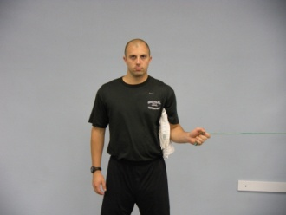
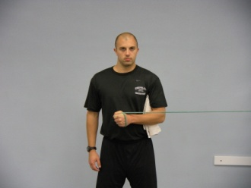
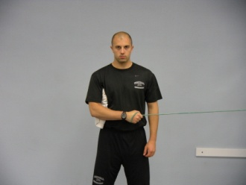
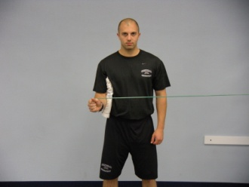
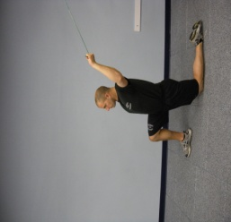
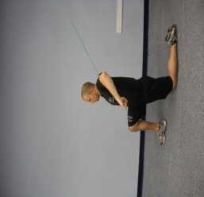
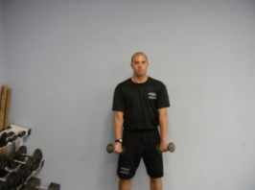
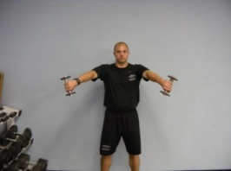
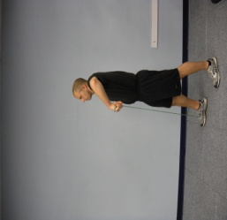
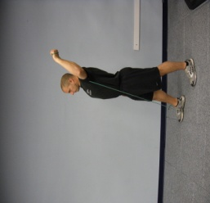
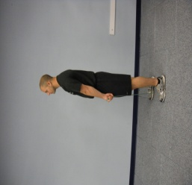
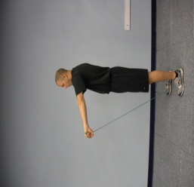
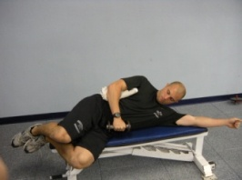
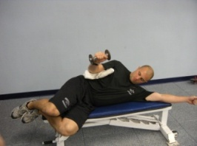
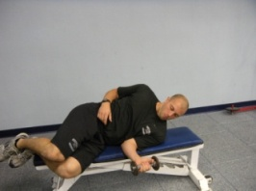
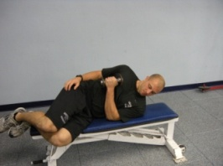
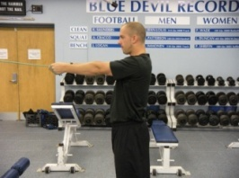
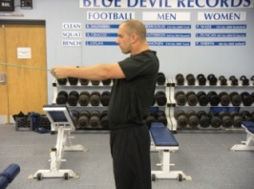
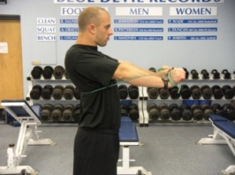
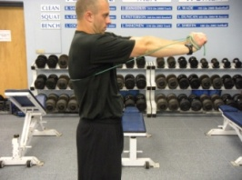
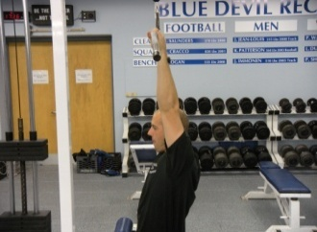
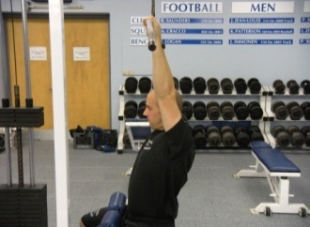
BLUE DEVIL SOFTBALL
Standing Internal Rotation With Towel
Standing External Rotation With Towel
Kneeling Overhead Internal Rotation
Standing External Rotation
Empty Cans With Bands
Empty Cans With Dumbbells
Lying External Rotation With Dumbbell
Lying Internal Rotation With Dumbbell
Standing Retraction With Bands
Standing Protraction With Bands
Scapular Depression With Lat Pull

Slide 23
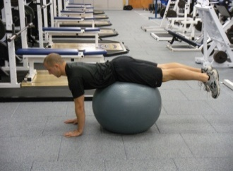
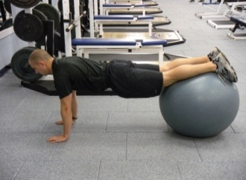
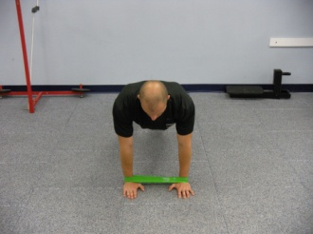
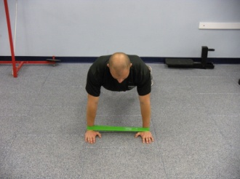
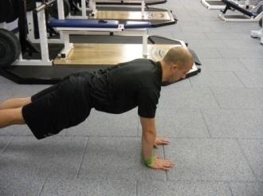
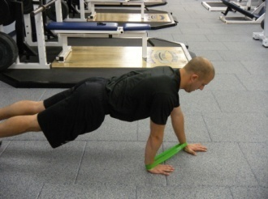
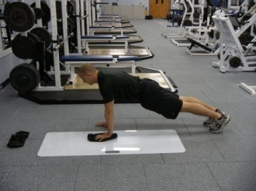
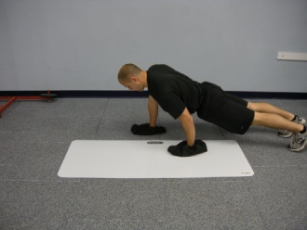
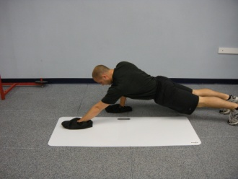
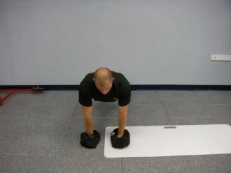
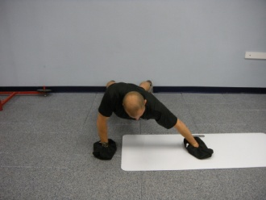
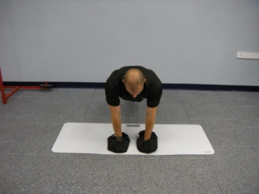
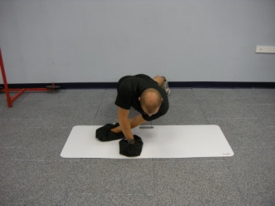
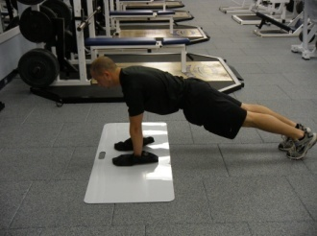
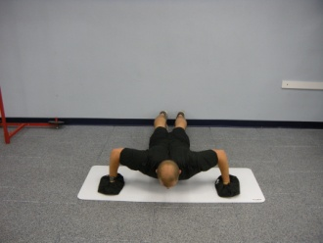
BLUE DEVIL SOFTBALL
Physio-Ball Walk-Outs
(With or Without Bands)
Lateral Band Walks
Frontwards and Backwards Band Walks
Slide Board Series
Figure 8
Front Raise
Side Push
Start in position above
Draw a figure 8 with the hand that is on the slide board
Start in position above on the left
Slide hand out as far as you can go
Pull arm back to start position
Start in position above on the left
Slide hand out as far as you can go
Pull arm back to start position
Cross Under
Push-Up With Slide
Start in position above on the left
Slide hand under until you feel discomfort
Pull arm back to start position
Start in position above on the left
Slide arms out into a push-up position
Pull arms back to start position

Slide 24
CONDITIONING
BLUE DEVIL SOFTBALL

Slide 25
BLUE DEVIL SOFTBALL
Weeks 1-3
 | Exercise | Emphasis | % of Best | Reps | Sets | Rest | Rest b/w Sets
Day 1 | 80 Yd. Sprints | Speed Endurance | 90-95 | 8 | 2 | 2 Min. | 7 Min.
Day 2 | Pro Agility | Speed Agility | 100 | 5 | 2 | :45s | 3 Min.
 | Nebraska | Speed Agility | 100 | 5 | 2 | :45s
Day 3 | OFF
Day 4 | 3-Cone Drill | Speed Agility | 100 | 5 ea. | 3 | :45s | 3 Min.
Day 5 | Half Gassers | Conditioning Test | 100 | 10/12/14 | 1 | 1 Min. | Make in :17s
 |  | Increase by 2 each week
Day 6 | Cross-Training | Cardio of your Choice
Day 7 | OFF
Weeks 4-7
 | Exercise | Emphasis | % of Best | Reps | Sets | Rest | Rest b/w Sets
Day 1 | 50 yd. sprints | Speed Endurance | 90-95 | 6 | 2 | 1 Min. | 5 Min.
Day 2 | Pro Agility | Speed Agility | 100 | 5 | 2 | :45s | 3 Min.
 | Nebraska | Speed Agility | 100 | 5 | 2 | :45s | 3 Min.
 | Colt | Speed Agility | 100 | 5 | 2 | :45s | 3 Min.
Day 3 | OFF
Day 4 | 4-Cone Drill | Speed Agility | 100 | 5 ea. | 3 | :45s | 3 Min.
Day 5 | Half Gassers | Conditioning Test | 100 | 12/14/16/18 | 1 | 1 Min. | Make in :17s
 |  | Increase by 2 each week
Day 6 | Cross-Training | Cardio of your Choice
Day 7 | OFF

Slide 26
BLUE DEVIL SOFTBALL
Weeks 8-10
 | Exercise | Emphasis | % of Best | Reps | Sets | Rest | Rest b/w Sets
Day 1 | 25 yd. Sprints | Speed | 90-95 | 8 | 2 | 3 Min. | 6 Min.
Day 2 | Pro Agility | Speed Agility | 100 | 5 | 2 | :45s | 3 Min.
 | Nebraska | Speed Agility | 100 | 5 | 2 | :45s | 3 Min.
 | Colt | Speed Agility | 100 | 5 | 2 | :45s | 3 Min.
 | Line | Speed Agility | 100 | 5 | 2 | :45s | 3 Min.
Day 3 | OFF
Day 4 | Side Shuffle Ball Toss | Speed Agility | 100 | 20 yds. Each way | 3 | :30s | 2 Min.
Day 5 | Half Gassers | Conditioning Test | 100 | 14/16/18 | 1 | 1:00 | Make in :17s
 |  | Increase by 2 each week
Day 6 | Cross-Training | Cardio of your Choice
Day 7 | OFF
Weeks 11-14
 | Exercise | Emphasis | % of Best | Reps | Sets | Rest | Rest b/w Sets
Day 1 | 25 yd. Sprints | Speed | 95-100 | 6 | 3 | 3 Min. | 6 Min.
Day 2 | Pro Agility | Speed Agility | 100 | 5 | 3 | :45s | 3 Min.
 | Nebraska | Speed Agility | 100 | 5 | 3 | :45s | 3 Min.
 | Colt | Speed Agility | 100 | 5 | 3 | :45s | 3 Min.
 | Line | Speed Agility | 100 | 5 | 3 | :45s | 3 Min.
Day 3 | 10 yd. Sprints | Acceleration | 95-100 | 10 | 2 | 2 Min. | 3 Min.
Day 4 | Weave Drill | Speed Agility | 100 | 5 ea. | 2 | 2 Min. | 3 Min.
Day 5 | Half Gassers | Conditioning Test | 100 | 14/16/18/18 | 1 | 1:00 | Make in :17s
 |  | Increase by 2 each week
Day 6 | OFF
Day 7 | OFF

Slide 27
BLUE DEVIL SOFTBALL
Pro Shuttle
Nebraska Shuttle
B
5 Yards
5 Yards
C
A
B
5 Yards
A
= Cone
= Cone
Start at Cone A in a 2-point stance.
Sprint to Cone B and touch the line with right foot.
Sprint to Cone C and touch the line with left foot.
Sprint through Cone A.
Start at Cone A in a 2-point stance.
Sprint around Cone B with the left shoulder closest to Cone B.
Sprint around Cone A with the right shoulder closest to Cone A.
Sprint to Cone B and touch the ground with both hands.
Backpedal through Cone A.

Slide 28
BLUE DEVIL SOFTBALL
Colt
Line Runs
D
5 Yards
C
5 Yards
C
5 Yards
B
5 Yards
B
5 Yards
A
A
= Cone
= Cone
Start at Cone A in a 2-point stance.
Sprint to Cone C and touch line with right foot, change direction and Sprint to Cone B, change direction and Sprint through Cone D.
Start at Cone A in a 2-point stance.
Sprint to Cone B and touch line with right foot, change direction and Sprint to Cone A and touch the line with left foot.
Sprint to Cone C and touch the line with right foot, change direction and Sprint to Cone A and touch the line with left foot.
Sprint to Cone B and touch line with right foot, change direction and Sprint through Cone A.

Slide 29
BLUE DEVIL SOFTBALL
3-Cone Drill
4-Cone Drill
A
5 Yards
A
D
5 Yards
5 Yards
5 Yards
5 Yards
B
5 Yards
C
B
C
5 Yards
= Cone
= Cone
Start at Cone A in a 2-Point Stance.
Back Pedal to Cone B and plant on left foot.
Cross-over run to Cone C and plant on right foot.
Shuffle through Cone A.
Start at Cone A in a 2-Point Stance.
Back Pedal to Cone B and plant of left foot.
Cross-over run to Cone C and plant on right foot.
Sprint to Cone D and plant on right foot.
Shuffle through Cone A.

Slide 30
BLUE DEVIL SOFTBALL
Weave Drill
5 Yards
A
5 Yards
B
5 Yards
C
5 Yards
D
5 Yards
E
= Cone
Start next to the first hurdle, facing laterally.
Hop over first hurdle, then back pedal around Cone A.
Sprint up to next hurdle, hop over hurdle and back pedal around Cone B.
Repeat for next 3 hurdles/2cones.
Hop over last hurdle and sprint through Cone E.

Slide 31
BLUE DEVIL SOFTBALL
Half Gassers
Side Shuffle Ball Toss
50 Yards
20 Yards
Start on sideline in a 2-Point Stance.
Sprint across the field, touch the line with your foot.
Sprint back and finish through the line.
Start on sideline facing your partner or a wall.
Side shuffle the given distance while tossing the ball back and forth to your partner.
Shuffle back to the start.

