Slide 1

Blue Devil
Men’s Soccer
Summer Goalie Program
Summer 2012

Slide 2
Blue Devils,
Welcome to the summer, hopefully everyone did well on their exams and is ready to begin summer workouts. The following packets includes a core workout for each day, a 12 week program, and a list of alternate exercises. The packet also includes a max sheet. To see the max sheet clearly increase the visibility to at least 130% The program is designed to maintain strength in preparation for the upcoming season. It is important to follow the program as it’s designed to the goals on the training phase. Included in each week of the program except for the recovery weeks are plyometric exercises that are paired up with a lift. They are to be done as a superset with that lift. They will improve your agility, jumping technique, jumping height, and landing technique. Also, there are videos of each exercise on the website so, if you have any questions about a video you can go to the video section of the website and click on a video and it will show you how to perform an exercise. If you have any questions about the program please email me at st_giampap@mail.ccsu.edu. Have a great summer!
Sincerely,
Coach Giampa

Slide 3
Abdominals/Low Back

Slide 4
Flexion/Extension |  |  | Plank | Rotation |  |  | Low Back
Choose 1 |  |  | Choose 1 | Choose 1: Perform |  |  | Choose 1: Perform 15 reps
 |  |  |  |  |  |  | Or Hold for :45
Regular Crunch |  |  | Side Plank Hold (Time) | Russian Twist |  |  | Dead Fish (Reps)
Crossover Crunch |  |  | Side Plank Leg Raises (Reps) | Rocky Twist |  |  | Dead Fish Hold (Time)
Elevated Crossover Crunch |  |  | Side Plank Leg Raise Hold (Time) | Prisoner Twist |  |  | Double Superman (Reps)
Side Crunch |  |  | Side Plank Hip Raises (Reps) | Squirm |  |  | Double Superman Hold (Time)
Curl Through |  |  | Side Plank Roll Unders/Hip Reach (Reps) |  |  |  | Cobra (Reps)
Wrist Curl |  |  | Front Plank Hold (Time) |  |  |  | Cobra Hold (Time)
Butterfly Crunch |  |  | Front Plank Arm Reach Hold (Time) |  |  |  | Alternate Superman (Reps)
 |  |  | Front Plank Arm Reaches (Reps) |  |  |  | Hip Bridge (Reps)
 |  |  | Front Plank Leg Raises (Reps) |  |  |  | Single Leg Hip Bridge (Reps)
 |  |  | Front Plank Leg Raise Hold (Time) |  |  |  | Hip Bridge Hold (Time)

Slide 5
Monday, May 28, 2012 |  |  | Tuesday, May 29, 2012
Exercise | Reps |  | Exercise | Reps
Side Plank | :45 |  | Flexion/Extension | 20
Flexion/Extension | 20 |  | Front Plank | :45
Rotation | 20 |  | Rotation | 20
Low Back |  |  | Low Back
Thursday, May 31, 2012 |  |  | Friday, June 1, 2012
Exercise | Reps |  | Exercise | Reps
Side Plank | :45 |  | Flexion/Extension | 20
Flexion/Extension | 20 |  | Front Plank | :45
Rotation | 20 |  | Rotation | 20
Low Back |  |  | Low Back
Monday, June 4, 2012 |  |  | Tuesday, June 5, 2012
Exercise | Reps |  | Exercise | Reps
Flexion/Extension | 20 |  | Side Plank | :45
Front Plank | :45 |  | Flexion/Extension | 20
Rotation | 20 |  | Rotation | 20
Low Back |  |  | Low Back
Thursday, June 7, 2012 |  |  | Friday, June 8, 2012
Exercise | Reps |  | Exercise | Reps
Flexion/Extension | 20 |  | Side Plank | :45
Front Plank | :45 |  | Flexion/Extension | 20
Rotation | 20 |  | Rotation | 20
Low Back |  |  | Low Back
Monday, June 11, 2012 |  |  | Tuesday, June 12, 2012
Exercise | Reps |  | Exercise | Reps
Side Plank | :45 |  | Flexion/Extension | 20
Flexion/Extension | 20 |  | Front Plank | :45
Rotation | 20 |  | Rotation | 20
Low Back |  |  | Low Back
Thursday, June 14, 2012 |  |  | Friday, June 15, 2012
Exercise | Reps |  | Exercise | Reps
Side Plank | :45 |  | Flexion/Extension | 20
Flexion/Extension | 20 |  | Front Plank | :45
Rotation | 20 |  | Rotation | 20
Low Back |  |  | Low Back

Slide 6
Monday, June 18, 2012 |  |  | Wednesday, June 20, 2012
Exercise | Reps |  | Exercise | Reps
Flexion/Extension | 25 |  | Side Plank | 1:00
Front Plank | 1:00 |  | Flexion/Extension | 25
Rotation | 25 |  | Rotation | 25
Low Back |  |  | Low Back
Friday, June 22, 2012 |  |  | Monday, June 25, 2012
Exercise | Reps |  | Exercise | Reps
Flexion/Extension | 25 |  | Side Plank | 1:00
Front Plank | 1:00 |  | Flexion/Extension | 25
Rotation | 25 |  | Rotation | 25
Low Back |  |  | Low Back
Tuesday, June 26, 2012 |  |  | Thursday, June 28, 2012
Exercise | Reps |  | Exercise | Reps
Flexion/Extension | 25 |  | Side Plank | 1:00
Front Plank | 1:00 |  | Flexion/Extension | 25
Rotation | 25 |  | Rotation | 25
Low Back |  |  | Low Back
Friday, June 29, 2012 |  |  | Monday, July 2, 2012
Exercise | Reps |  | Exercise | Reps
Flexion/Extension | 25 |  | Flexion/Extension | 25
Front Plank | 1:00 |  | Front Plank | 1:00
Rotation | 25 |  | Rotation | 25
Low Back |  |  | Low Back
Tuesday, July 3, 2012 |  |  | Thursday, July 5, 2012
Exercise | Reps |  | Exercise | Reps
Side Plank | 1:00 |  | Flexion/Extension | 25
Flexion/Extension | 25 |  | Front Plank | 1:00
Rotation | 25 |  | Rotation | 25
Low Back |  |  | Low Back
Friday, July 6, 2012 |  |  | Monday, July 9, 2012
Exercise | Reps |  | Exercise | Reps
Side Plank | 1:00 |  | Side Plank | 1:15
Flexion/Extension | 25 |  | Flexion/Extension | 30
Rotation | 25 |  | Rotation | 30
Low Back |  |  | Low Back

Slide 7
Tuesday, July 10, 2012 |  |  | Thursday, July 12, 2012
Exercise | Reps |  | Exercise | Reps
Flexion/Extension | 30 |  | Side Plank | 1:15
Front Plank | 1:15 |  | Flexion/Extension | 30
Rotation | 30 |  | Rotation | 30
Low Back |  |  | Low Back
Friday, July 13, 2012 |  |  | Monday, July 16, 2012
Exercise | Reps |  | Exercise | Reps
Flexion/Extension | 30 |  | Flexion/Extension | 30
Front Plank | 1:15 |  | Front Plank | 1:15
Rotation | 30 |  | Rotation | 30
Low Back |  |  | Low Back
Wednesday, July 18, 2012 |  |  | Friday, July 20, 2012
Exercise | Reps |  | Exercise | Reps
Side Plank | 1:15 |  | Flexion/Extension | 30
Flexion/Extension | 30 |  | Front Plank | 1:15
Rotation | 30 |  | Rotation | 30
Low Back |  |  | Low Back
Monday, July 23, 2012 |  |  | Tuesday, July 24, 2012
Exercise | Reps |  | Exercise | Reps
Side Plank | 1:15 |  | Flexion/Extension | 30
Flexion/Extension | 30 |  | Front Plank | 1:15
Rotation | 30 |  | Rotation | 30
Low Back |  |  | Low Back
Thursday, July 26, 2012 |  |  | Friday, July 27, 2012
Exercise | Reps |  | Exercise | Reps
Side Plank | 1:15 |  | Flexion/Extension | 30
Flexion/Extension | 30 |  | Front Plank | 1:15
Rotation | 30 |  | Rotation | 30
Low Back |  |  | Low Back
Monday, July 30, 2012 |  |  | Tuesday, July 31, 2012
Exercise | Reps |  | Exercise | Reps
Flexion/Extension | 35 |  | Side Plank | 1:30
Front Plank | 1:30 |  | Flexion/Extension | 35
Rotation | 35 |  | Rotation | 35
Low Back |  |  | Low Back

Slide 8
Thursday, August 2, 2012 |  |  | Friday, August 3, 2012
Exercise | Reps |  | Exercise |  | Reps
Flexion/Extension | 35 |  | Side Plank |  | 1:30
Front Plank | 1:30 |  | Flexion/Extension |  | 35
Rotation | 35 |  | Rotation |  | 35
Low Back |  |  | Low Back
Monday, August 6, 2012 |  |  | Tuesday, August 7, 2012
Exercise | Reps |  | Exercise |  | Reps
Side Plank | 1:30 |  | Flexion/Extension |  | 35
Flexion/Extension | 35 |  | Front Plank |  | 1:30
Rotation | 35 |  | Rotation |  | 35
Low Back |  |  | Low Back
Thursday, August 9, 2012 |  |  | Friday, August 10, 2012
Exercise | Reps |  | Exercise |  | Reps
Side Plank | 1:30 |  | Flexion/Extension |  | 35
Flexion/Extension | 35 |  | Front Plank |  | 1:30
Rotation | 35 |  | Rotation |  | 35
Low Back |  |  | Low Back
Monday, August 13, 2012 |  |  | Wednesday, August 15, 2012
Exercise | Reps |  | Exercise |  | Reps
Flexion/Extension | 35 |  | Side Plank |  | 1:30
Front Plank | 1:30 |  | Flexion/Extension |  | 35
Rotation | 35 |  | Rotation |  | 35
Low Back |  |  | Low Back
Friday, August 17, 2012
Exercise | Reps
Flexion/Extension | 35
Front Plank | 1:30
Rotation | 35
Low Back

Slide 9
Workout

Slide 10
Blue Devil Men's Soccer
Week 1
Monday, May 28, 2012
Exercise | w/up | w/up | Work set | Sets
Single Arm DB Push Press (80% Push) | 3-65% | 3-75% | 6-85% | 3
Bench Press | 6-60% | 6-60% | 12-70% | 3
Lat Pulldown |  |  | 12-70% | 3
3-Way Shoulder |  |  | 6 Each | 2
Inverted Row |  |  | Failure | 2
Super Circuit | DB Curls/Overhead Extensions |  | 12 | 2
Tuesday, May 29, 2012
Exercise | w/up | w/up | Work set | Sets
Jump Shrug | 3-65% | 3-75% | 6-85% | 3
Backsquat | 6-60% | 6-60% | 12-70% | 3
Squat Jumps | Superset with Backsquat |  | 6 | 2
RDL | Use Jump Shrug Weight |  | 12 | 3
Step-ups | Use 30% Backsquat Max |  | 12 Each | 2
Jump and Reach | Superset with Step-ups |  | 6 Each | 2
4-Way Physioball Hamstring |  |  | 6 Each | 2
Hyperextensions |  |  | 12 | 2
Thursday, May 31, 2012
Exercise | w/up | w/up | Work set | Sets
Single Arm DB Push Press (80% Push) | 6-55% | 6-65% | 6-75% | 3
Incline Bench Press | 6-55% | 6-65% | 6-75% | 3
Pull-ups |  |  | Failure | 3
Shoulder Press |  |  | 6-75% | 2
Seated Row |  |  | 6-75% | 2
Push-ups |  |  | 6+ | 2
Friday, June 1, 2012
Exercise | w/up | w/up | Work set | Sets
Jump Shrug | 6-55% | 6-65% | 6-75% | 3
Backsquat | 6-55% | 6-65% | 6-75% | 3
Double Leg Vertical Jumps | Superset with Backsquat |  | 6 | 2
Med-Ball Hip Raise |  |  | 6 | 3
Bulgarian Split Squat | Use 30% Backsquat Max |  | 6 Each | 2
Single Leg Push-Offs | Superset with Bulgarian Split |  | 6 Each | 2
4-Way Med-Ball Hamstring |  |  | 6 Each | 2
Reverse Hyperextensions |  |  | 6 | 2

Slide 11
Blue Devil Men's Soccer
Week 2
Monday, June 4, 2012
Exercise | w/up | w/up | Work set | Sets
Jump Shrug | 5-65% | 5-75% | 5-87.5% | 3
Backsquat | 5-55% | 5-65% | 10-75% | 3
Box Jumps | Superset with Backsquat |  | 5 | 2
DB RDL (80% Clean) | Two DB's Should Equal Weight |  | 10-75% | 3
Forward Lunge | Use 32.5% Backsquat Max |  | 10 Each | 2
Split Squat Jumps | Superset with Forward Lunge |  | 5 Each | 2
Physioball Hip Raise |  |  | 10 | 2
Hyperextensions |  |  | 10 | 2
Tuesday, June 5, 2012
Exercise | w/up | w/up | Work set | Sets
Single Arm DB Push Press (80% Push) | 5-65% | 5-75% | 5-87.5% | 3
DB Incline Bench Press (80% Incline) | 5-55% | 5-65% | 10-75% | 3
Pull-ups |  |  | Failure | 3
Upright Row |  |  | 10-75% | 2
Bentover Row | Use 80% Seated Row Max |  | 10-75% | 2
Super Circuit | Straight Bar/Close Grip Bench |  | 10 | 2
Thursday, June 7, 2012
Exercise | w/up | w/up | Work set | Sets
Jump Shrug | 5-55% | 5-65% | 5-77.5% | 3
Backsquat | 5-55% | 5-65% | 5-77.5% | 3
Box Jumps | Superset with Backsquat |  | 5 | 2
4-Way Med-Ball Hamstring |  |  | 5 Each | 3
Backwards Lunge | Use 32.5% Backsquat Max |  | 5 Each | 2
Cycled Split Squat Jumps | Superset with Backwards Lunge |  | 5 | 2
Sinlge Leg DB RDL (80% Clean) | Cut Weight in Half |  | 5-77.5% | 2
Reverse Hyperextensions |  |  | 5 | 2
Friday, June 8, 2012
Exercise | w/up | w/up | Work set | Sets
Jump Shrug | 5-55% | 5-65% | 5-77.5% | 3
DB Bench Press (80% Bench Max) | 5-55% | 5-65% | 5-77.5% | 3
Lat Pulldown |  |  | 5-77.5% | 3
3-Way Shoulder |  |  | 5 Each | 2
Inverted Row |  |  | Failure | 2
Push-ups |  |  | 5+ | 2

Slide 12
Blue Devil Men's Soccer
Week 3
Monday, June 11, 2012
Exercise | w/up | w/up | Work set | Sets
Single Arm DB Push Press (80% Push) | 4-70% | 4-80% | 4-90% | 3
Bench Press | 4-60% | 4-70% | 8-80% | 3
Lat Pulldown |  |  | 8-80% | 3
Shoulder Press |  |  | 8 Each | 2
Seated Row |  |  | 8-80% | 2
Super Circuit | EZ Curls/Skullcrushers |  | 8 | 2
Tuesday, June 12, 2012
Exercise | w/up | w/up | Work set | Sets
Jump Shrug | 4-70% | 4-80% | 4-90% | 3
Backsquat | 4-60% | 4-70% | 8-80% | 3
Tuck Jumps | Superset with Backsquat |  | 8 | 2
RDL | Use Jump Shrug Weight |  | 8 | 3
Split Squat | Use 35% Backsquat Max |  | 8 Each | 2
Double Leg Line Jumps Forward | Superset with Split Squat |  | 8 | 2
4-Way Physioball Hamstring |  |  | 8 Each | 2
Hyperextensions |  |  | 8 | 2
Thursday, June 14, 2012
Exercise | w/up | w/up | Work set | Sets
Box Jumps |  |  | 4 | 3
Incline Bench Press | 4-60% | 4-70% | 4-82.5% | 3
Pull-ups |  |  | Failure | 3
Upright Row |  |  | 4-82.5% | 2
Inverted Row |  |  | Failure | 2
Push-ups |  |  | Failure | 2
Friday, June 15, 2012
Exercise | w/up | w/up | Work set | Sets
Jump Shrug | 4-60% | 4-70% | 4-80% | 3
Backsquat | 4-60% | 4-70% | 4-82.5% | 3
Double Leg Line Jumps Lateral | Superset with Backsquat |  | 8 | 2
4-Way Med-Ball Hamstring |  |  | 4 Each | 3
Overhead Split Squat | Barbell |  | 4 Each | 2
Squat Box Jumps Forward | Superset with OH Split Squat |  | 8 | 2
Med-Ball Hip Raise |  |  | 4 | 2
Reverse Hyperextensions |  |  | 4 | 2

Slide 13
Blue Devil Men's Soccer
Week 4: Recovery Week (No Extra Reps!)
Monday, June 18, 2012
Exercise | w/up | w/up | Work set | Sets
Jump Shrug |  | 4-60% | 4-70% | 2
Backsquat |  | 4-60% | 4-72.5% | 2
4-Way Physioball Hamstring |  |  | 4 Each | 2
Step-ups | Use 30% Backsquat Max |  | 4 Each | 2
Single Leg DB RDL (80% Clean) | Cut Weight in Half |  | 4-72.5% | 2
Hyperextensions |  |  | 4 | 2
Wednesday, June 20, 2012
Exercise | w/up | w/up | Work set | Sets
Single Arm DB Push Press (80% Push) |  | 4-60% | 4-70% | 2
DB Incline Bench Press (80% Incline) |  | 4-60% | 4-72.5% | 2
Pull-ups |  |  | Failure | 2
DB Shoulder Press |  |  | 4-72.5% | 2
Bentover Row | Use 80% Seated Row Max |  | 4-72.5% | 2
Super Circuit | DB Curls/Overhead Extensions |  | 4 | 2
Friday, June 22, 2012
Exercise | w/up | w/up | Work set | Sets
Jump Shrug |  | 4-60% | 4-70% | 2
Backsquat |  | 4-60% | 4-72.5% | 2
DB Bench Press (80% Bench Max) |  | 4-60% | 4-72.5% | 2
RDL | Use Jump Shrug Weight |  | 4 | 2
Lat Pulldown |  |  | 4-72.5% | 2
Reverse Hyperextensions |  |  | 4 | 2

Slide 14
Blue Devil Men's Soccer
Week 5
Monday, June 25, 2012
Exercise | w/up | w/up | Work set | Sets
DB Push Press (80% Push Press Max) | 5-65% | 5-75% | 5-87.5% | 3
DB Bench Press (80% Bench Press Max) | 5-55% | 5-65% | 10-75% | 3
Lat Pulldown |  |  | 10-75% | 3
3-Way Shoulder |  |  | 5 Each | 2
Seated Row |  |  | 10-75% | 2
Super Circuit | Straight Bar/Close Grip Bench |  | 10 | 2
Tuesday, June 26, 2012
Exercise | w/up | w/up | Work set | Sets
Power Pull | 5-65% | 5-75% | 5-87.5% | 3
Backsquat | 5-55% | 5-65% | 10-75% | 3
Lateral Box Jumps (Stick) | Superset with Backsquat |  | 5 Each | 3
RDL | Use Power Pull Weight |  | 10 | 3
Forward Lunge | Use 32.5% Backsquat Max |  | 10 Each | 2
Single Leg Line Jumps Forward | Superset with Forward Lunge |  | 10 | 2
Med-Ball Hip Raise |  |  | 10 | 2
Hyperextensions |  |  | 10 | 2
Thursday, June 28, 2012
Exercise | w/up | w/up | Work set | Sets
Box Jumps |  |  | 5 | 3
DB Incline Bench Press (80% Incline Max) | 5-55% | 5-65% | 5-77.5% | 3
Pull-ups |  |  | Failure | 3
DB Shoulder Press (80% Shoulder Max) |  |  | 5-77.5% | 2
Inverted Row |  |  | Failure | 2
Push-ups |  |  | Failure | 2
Friday, June 29, 2012
Exercise | w/up | w/up | Work set | Sets
Jump Shrug | 5-55% | 5-65% | 5-77.5% | 3
Backsquat | 5-55% | 5-65% | 5-77.5% | 3
Single Leg Line Jumps Lateral (Stick) | Superset with Backsquat |  | 5 Each | 3
Single Leg DB RDL (80% Clean) | Cut Weight in Half |  | 5-77.5% | 3
Overhead Split Squat | Use 20% Backsquat Max |  | 5 Each | 2
Single Leg Tuck Jump | Superset with OH Split Squat |  | 5 | 2
4-Way Med-Ball Hamstring |  |  | 5 Each | 2
Reverse Hyperextensions |  |  | 5 | 2

Slide 15
Blue Devil Men's Soccer
Week 6
Monday, July 2, 2012
Exercise | w/up | w/up | Work set | Sets
Power Pull | 4-70% | 4-80% | 4-90% | 3
Backsquat | 4-60% | 4-70% | 8-80% | 3
Single Leg Box Jumps Forward | Superset with Backsquat |  | 8 Each | 3
4-Way Physioball Hamstring |  |  | 8 Each | 3
Backwards Lunge | Use 35% Backsquat Max |  | 8 Each | 2
Single Leg Box Jumps Lateral | Superset with Backwards Lunge |  | 8 Each | 2
Physioball Hip Raise |  |  | 8 | 2
Hyperextensions |  |  | 8 | 2
Tuesday, July 3, 2012
Exercise | w/up | w/up | Work set | Sets
Push Press | 4-70% | 4-80% | 4-90% | 3
Incline Bench Press | 4-60% | 4-70% | 8-80% | 3
Pull-ups |  |  | Failure | 3
Shoulder Press |  |  | 8-80% | 2
Bentover Row | Use 80% Seated Row Max |  | 8-80% | 2
Super Circuit | EZ Curls/Skullcrushers |  | 8 | 2
Thursday, July 5, 2012
Exercise | w/up | w/up | Work set | Sets
Jump Shrug | 4-60% | 4-70% | 4-80% | 3
Backsquat | 4-60% | 4-70% | 4-82.5% | 3
Depth Jumps | Superset with Backsquat |  | 8 | 3
RDL | Use Jump Shrug Weight |  | 4 | 3
Lateral Lunge | Use 35% Backsquat Max |  | 4 Each | 2
Cycled Split Squat Jumps | Superset with Lateral Lunge |  | 8 | 2
Single Leg DB RDL (80% Clean) | Cut Weight in Half |  | 4-82.5% | 2
Reverse Hyperextensions |  |  | 4 | 2
Friday, July 6, 2012
Exercise | w/up | w/up | Work set | Sets
Box Jumps |  |  | 4 | 3
Bench Press | 4-60% | 4-70% | 4-82.5% | 3
Lat Pulldown |  |  | 4-82.5% | 3
Upright Row |  |  | 4 Each | 2
Seated Row |  |  | 4-82.5% | 2
Push-ups |  |  | Failure | 2

Slide 16
Blue Devil Men's Soccer
Week 7
Monday, July 9, 2012
Exercise | w/up | w/up | Work set | Sets
Push Press | 3-70% | 3-80% | 3-92.5% | 3
DB Bench Press (80% Bench Max) | 3-65% | 3-75% | 6-85% | 3
Lat Pulldown |  |  | 6-85% | 3
3-Way Shoulder |  |  | 6 Each | 2
Inverted Row |  |  | Failure | 2
Super Circuit | DB Curls/Overhead Extensions |  | 6 | 2
Tuesday, July 10, 2012
Exercise | w/up | w/up | Work set | Sets
Power Pull | 3-70% | 3-80% | 3-92.5% | 3
Backsquat | 3-65% | 3-75% | 6-85% | 3
Depth Jumps | Superset with Backsquat |  | 6 | 3
RDL | Use Power Pull Weight |  | 6 | 3
Bulgarian Split Squat | Use 37.5% Backsquat Max |  | 6 Each | 2
Depth Jumps to Vertical Jump | Superset with Bulgarian Split |  | 6 | 2
4-Way Med-Ball Hamstring |  |  | 6 Each | 2
Hyperextensions |  |  | 6 | 2
Thursday, July 12, 2012
Exercise | w/up | w/up | Work set | Sets
Box Jumps |  |  | 6 | 3
DB Incline Bench Press (80% Incline Max) | 3-65% | 3-75% | 3-87.5% | 3
Pull-ups |  |  | Failure | 3
DB Shoulder Press (80% Shoulder Max) |  |  | 3-87.5% | 2
Bentover Row | Use 80% Seated Row Max |  | 3-87.5% | 2
Push-ups |  |  | Failure | 2
Friday, July 13, 2012
Exercise | w/up | w/up | Work set | Sets
Jump Shrug | 3-60% | 3-70% | 3-82.5% | 3
Backsquat | 3-65% | 3-75% | 3-87.5% | 3
Depth Jump to Land to 2 Line Jumps | Superset with Backsquat |  | 6 | 3
Med-Ball Hip Raise |  |  | 3 | 3
Step-ups | Use 37.5% Backsquat Max |  | 3 Each | 2
Depth Jump to 2 Vertical Jumps | Superset with Step-ups |  | 6 | 2
4-Way Physioball Hamstring |  |  | 3 Each | 2
Reverse Hyperextensions |  |  | 6 | 2

Slide 17
Blue Devil Men's Soccer
Week 8: Recovery Week (No Extra Reps!)
Monday, July 16, 2012
Exercise | w/up | w/up | Work set | Sets
Power Pull |  | 3-60% | 3-72.5% | 2
Backsquat |  | 3-65% | 3-77.5% | 2
Single Leg DB RDL (80% Clean) | Cut Weight in Half |  | 3-77.5% | 2
Forward Lunge | Use 30% Backsquat Max |  | 3 Each | 2
Med-Ball Hip Raise |  |  | 3 | 2
Hyperextensions |  |  | 6 | 2
Wednesday, July 18, 2012
Exercise | w/up | w/up | Work set | Sets
Push Press |  | 3-60% | 3-72.5% | 2
Incline Bench Press |  | 3-65% | 3-77.5% | 2
Pull-ups |  |  | Failure | 2
Upright Row |  |  | 3-77.5% | 2
Seated Row |  |  | 3-77.5% | 2
Super Circuit | Straight Bar/Close Grip Bench |  | 6 | 2
Friday, July 20, 2012
Exercise | w/up | w/up | Work set | Sets
Jump Shrug | 3-50% | 3-60% | 3-72.5% | 2
Bench Press |  | 3-65% | 3-77.5% | 2
Backsquat |  | 3-65% | 3-77.5% | 2
Lat Pulldown |  |  | 3-77.5% | 2
RDL | Use Jump Shrug Weight |  | 3 | 2
Push-ups |  |  | Failure | 2

Slide 18
Blue Devil Men's Soccer
Week 9
Monday, July 23, 2012
Exercise | w/up | w/up | Work set | Sets
Push Press | 4-70% | 4-80% | 4-90% | 3
Bench Press | 4-60% | 4-70% | 8-80% | 3
Lat Pulldown |  |  | 8-80% | 3
3-Way Shoulder |  |  | 8 Each | 2
Bentover Row | Use 80% Seated Row Max |  | 8-80% | 2
Super Circuit | EZ Curls/Skullcrushers |  | 8 | 2
Tuesday, July 24, 2012
Exercise | w/up | w/up | Work set | Sets
Power Pull | 4-70% | 4-80% | 4-90% | 3
Backsquat | 4-60% | 4-70% | 8-80% | 3
Double Leg Line Jumps Lateral (Continuous) | Superset with Backsquat |  | 8 | 3
RDL | Use Power Pull Weight |  | 8 | 3
Lateral Lunge | Use 35% Backsquat Max |  | 8 Each | 2
Double Leg Line Jumps Forward (Continuous) | Superset with Lateral Lunge |  | 8 | 2
4-Way Physioball Hamstring |  |  | 8 Each | 2
Hyperextensions |  |  | 8 | 2
Thursday, July 26, 2012
Exercise | w/up | w/up | Work set | Sets
Box Jumps |  |  | 4 | 3
Incline Bench Press | 4-60% | 4-70% | 4-82.5% | 3
Pull-ups |  |  | Failure | 3
Shoulder Press |  |  | 4-82.5% | 2
Inverted Row |  |  | Failure | 2
Push-ups |  |  | Failure | 2
Friday, July 27, 2012
Exercise | w/up | w/up | Work set | Sets
Jump Shrug | 4-60% | 4-70% | 4-80% | 3
Backsquat | 4-60% | 4-70% | 4-82.5% | 3
Skater Drives | Superset with Backsquat |  | 8 | 3
Single Leg DB RDL (80% Clean) | Cut Weight in Half |  | 4-82.5% | 3
Overhead Forward Lunge | Use 10% Backsquat Max |  | 4 Each | 2
Box Drill (Quickly Jump around the box) | Superset with OH Forward Lunge |  | 8 | 2
Med-Ball Hip Raise |  |  | 4 | 2
Reverse Hyperextensions |  |  | 4 | 2

Slide 19
Blue Devil Men's Soccer
Week 10
Monday, July 30, 2012
Exercise | w/up | w/up | Work set | Sets
Power Pull | 3-70% | 3-80% | 3-92.5% | 3
Backsquat | 3-65% | 3-75% | 6-85% | 3
Box Jumps | Superset with Backsquat |  | 6 | 3
4-Way Med-Ball Hamstring |  |  | 6 Each | 3
Step-ups | Use 37.5% Backsquat Max |  | 6 Each | 2
Single Leg Box Jumps Forward | Superset with Step-ups |  | 6 Each | 2
Med-Ball Hip Raise |  |  | 6 | 2
Hyperextensions |  |  | 6 | 2
Tuesday, 31, 2012
Exercise | w/up | w/up | Work set | Sets
Push Press | 3-70% | 3-80% | 3-92.5% | 3
DB Incline Bench Press (80% Incline) | 3-65% | 3-75% | 6-85% | 3
Pull-ups |  |  | Failure | 3
Upright Row |  |  | 6-85% | 2
Seated Row |  |  | 6-85% | 2
Super Circuit | DB Curls/Overhead Extensions |  | 6 | 2
Thursday, August 2, 2012
Exercise | w/up | w/up | Work set | Sets
Jump Shrug | 3-60% | 3-70% | 3-82.5% | 3
Backsquat | 3-65% | 3-75% | 3-87.5% | 3
Single Leg Box Jumps Lateral | Superset with Backsquat |  | 6 Each | 3
RDL | Use Jump Shrug Weight |  | 3 | 3
Split Squat | Use 37.5% Backsquat Max |  | 3 Each | 2
Single Leg Push-Offs | Superset with Split Squat |  | 6 Each | 2
Single Leg DB RDL (80% Clean) | Cut Weight in Half |  | 3-87.5% | 2
Reverse Hyperextensions |  |  | 6 | 2
Friday, August 3, 2012
Exercise | w/up | w/up | Work set | Sets
Box Jumps |  |  | 6 | 3
DB Bench Press (80% Bench Max) | 3-65% | 3-75% | 3-87.5% | 3
Lat Pulldown |  | 3-75% | 3-87.5% | 3
3-Way Shoulder |  |  | 3 Each | 2
Inverted Row |  |  | Failure | 2
Push-ups |  |  | Failure | 2

Slide 20
Blue Devil Men's Soccer
Week 11
Monday, August 6, 2012
Exercise | w/up | w/up | Work set | Sets
Push Press | 2-75% | 2-85% | 2-95% | 3
Bench Press | 4-70% | 4-80% | 4-90% | 3
Lat Pulldown |  |  | 4-90% | 3
Upright Row |  |  | 4 Each | 2
Bentover Row | Use 80% Seated Row Max |  | 4-90% | 2
Super Circuit | Straight Bar/Close Grip Bench |  | 4 | 2
Tuesday, August 7, 2012
Exercise | w/up | w/up | Work set | Sets
Power Pull | 2-75% | 2-85% | 2-95% | 3
Backsquat | 4-70% | 4-80% | 4-90% | 3
Tuck Jumps | Superset with Backsquat |  | 8 | 3
RDL | Use Power Pull Weight |  | 4 | 3
Forward Lunge | Use 40% Backsquat Max |  | 4 Each | 2
Single Leg Tuck Jumps | Superset with Forward Lunge |  | 8 Each | 2
4-Way Physioball Hamstring |  |  | 4 Each | 2
Hyperextensions |  |  | 4 | 2
Thursday, August 9, 2012
Exercise | w/up | w/up | Work set | Sets
Box Jumps |  |  | 4 | 3
Incline Bench Press | 2-70% | 2-80% | 2-92.5% | 3
Pull-ups |  |  | Failure | 3
Shoulder Press |  |  | 2-92.5% | 2
Seated Row |  |  | 2-92.5% | 2
Push-ups |  |  | Failure | 2
Friday, August 10, 2012
Exercise | w/up | w/up | Work set | Sets
Jump Shrug | 2-65% | 2-75% | 2-85% | 3
Backsquat | 2-70% | 2-80% | 2-92.5% | 3
Double Leg Line Jumps Forward | Superset with Backsquat |  | 8 | 3
Single Leg DB RDL (80% Clean) | Cut Weight in Half |  | 4-92.5% | 3
Overhead Forward Lunge | Use 20% Backsquat Max |  | 2 Each | 2
Double Leg Line Jumps Lateral (Continuous) | Superset with OH Forward Lunge |  | 8 | 2
Med-Ball Hip Raise |  |  | 4 Each | 2
Reverse Hyperextensions |  |  | 4 | 2

Slide 21
Blue Devil Men's Soccer
Week 12: Recovery Week (No Extra Reps!)
Monday, August 13, 2012
Exercise | w/up | w/up | Work set | Sets
Power Pull |  | 2-65% | 2-75% | 2
Backsquat |  | 2-75% | 2-82.5% | 2
4-Way Med-Ball Hamstring |  |  | 2 Each | 2
Lateral Lunge | Use 30% Backsquat Max |  | 2 Each | 2
Med-Ball Hip Raise |  |  | 2 | 2
Hyperextensions |  |  | 2 | 2
Wednesday, August 15, 2012
Exercise | w/up | w/up | Work set | Sets
Push Press |  | 2-65% | 2-75% | 2
Incline Bench Press |  | 2-75% | 2-82.5% | 2
Pull-ups |  |  | Failure | 2
Shoulder Press |  |  | 2-82.5% | 2
Seated Row |  |  | 2-82.5% | 2
Super Circuit | EZ Curls/Skullcrushers |  | 4 | 2
Friday, August 17, 2012
Exercise | w/up | w/up | Work set | Sets
Jump Shrug |  | 2-65% | 2-75% | 2
Bench Press | 2-65% | 2-75% | 2-82.5% | 2
RDL |  |  | 2 | 2
Lat Pulldown |  |  | 2-82.5% | 2
Bulgarian Split Squat | Use 30% Backsquat Max |  | 2 Each | 2
Reverse Hyperextensions |  |  | 4 | 2

Slide 22
Max Sheet

Slide 23
Blue Devil Men's Soccer
 | Power Pull |  |  |  | SQUAT |  |  |  | SNATCH |  |  |  | PUSH PRESS |  |  |  | BENCH |  |  |  | LAT PULLDOWN |  |  |  | INCLINE |  | SEATED |  | SHOULDER |  | UPRIGHT
MAX CHART | MAX | WU | WU | WS | MAX | WU | WU | WS | MAX | WU | WU | WS | MAX | WU | WU | WS | MAX | WU | WU | WS | MAX | WU | WU | WS | MAX | WS | MAX | WS | MAX | WS | MAX | WS
NAME |  | 75.0% | 85.0% | 95.0% |  | 70.0% | 80.0% | 90.0% |  | 0.0% | 0.0% | 0.0% |  | 75.0% | 85.0% | 95.0% |  | 0.0% | 0.0% | 90.0% |  | 0.0% | 0.0% | 0.0% |  | 0.0% |  | 90.0% |  | 90.0% | 0 | 0.0%
Abelse, Josef | 160 | 0 | 140 | 155 | 245 | 175 | 200 | 225 |  | 0 | 0 | 0 | 155 | 120 | 135 | 150 | 190 | 0 | 0 | 175 | 225 | 0 | 0 | 0 | 165 | 0 | 230 | 210 | 125 | 115 | 130 | 0
Bailey, Steven | 140 | 105 | 120 | 135 | 220 | 155 | 180 | 200 |  | 0 | 0 | 0 | 115 | 90 |  | 110 | 145 | 0 | 0 | 135 | 190 | 0 | 0 | 0 | 165 | 0 | 190 | 175 | 115 | 105 | 120 | 0
Bogle, Eddy | 130 | 100 | 115 | 125 | 300 | 210 | 240 | 270 |  | 0 | 0 | 0 | 145 | 110 | 125 | 140 | 165 | 0 | 0 | 150 | 175 | 0 | 0 | 0 | 145 | 0 | 165 | 150 | 110 | 100 | 110 | 0
Chao, Josh | 145 | 110 | 125 | 140 | 330 | 235 | 265 | 300 |  | 0 | 0 | 0 | 170 | 130 | 145 | 165 | 160 | 0 | 0 | 145 | 185 | 0 | 0 | 0 | 120 | 0 | 215 | 195 | 115 | 105 | 120 | 0
Dioubate, Alpha | 135 | 105 | 115 | 130 | 190 | 135 | 155 | 175 |  | 0 | 0 | 0 | 150 | 115 | 130 | 145 | 145 | 0 | 0 | 135 | 180 | 0 | 0 | 0 | 120 | 0 | 225 | 205 | 110 | 100 | 115 | 0
Dioubate, Mamaoudou | 155 | 120 | 135 | 150 | 235 | 165 | 190 | 215 |  | 0 | 0 | 0 | 125 | 95 | 110 | 120 | 225 | 0 | 0 | 205 | 200 | 0 | 0 | 0 | 200 | 0 | 185 | 170 | 90 | 85 | 85 | 0
DiTommaso, Sal | 190 | 145 | 165 | 185 | 205 | 145 | 165 | 185 |  | 0 | 0 | 0 | 150 | 115 | 130 | 145 | 140 | 0 | 0 | 130 | 200 | 0 | 0 | 0 | 115 | 0 | 135 | 125 | 90 | 85 | 100 | 0
Gamboa, Jose | 140 | 105 | 120 | 135 | 285 | 200 | 230 | 260 |  | 0 | 0 | 0 | 145 | 110 | 125 | 140 | 150 | 0 | 0 | 135 | 215 | 0 | 0 | 0 | 120 | 0 | 175 | 160 | 115 | 105 | 115 | 0
Kurzatkowski, Mariusz | 85 | 65 | 75 | 85 | 170 | 120 | 140 | 155 |  | 0 | 0 | 0 | 105 | 80 | 90 | 100 | 185 | 0 | 0 | 170 | 200 | 0 | 0 | 0 | 130 | 0 | 135 | 125 | 115 | 105 | 95 | 0
Martins, Tiago | 140 | 105 | 120 | 135 | 255 | 180 | 205 | 230 |  | 0 | 0 | 0 | 145 | 110 | 125 | 140 | 155 | 0 | 0 | 140 | 160 | 0 | 0 | 0 | 135 | 0 | 150 | 135 | 105 | 95 | 100 | 0
Menzies, Jesse | 215 | 165 | 185 | 205 | 335 | 235 | 270 | 305 |  | 0 | 0 | 0 | 205 | 155 | 175 | 195 | 235 | 0 | 0 | 215 | 205 | 0 | 0 | 0 | 235 | 0 | 215 | 195 | 155 | 140 | 125 | 0
Nobre, Manny | 145 | 110 | 125 | 140 | 260 | 185 | 210 | 235 |  | 0 | 0 | 0 | 160 | 120 | 140 | 155 | 185 | 0 | 0 | 170 | 200 | 0 | 0 | 0 | 165 | 0 | 175 | 160 | 115 | 105 | 115 | 0
Obasi, Thomas | 135 | 105 | 115 | 130 | 235 | 165 | 190 | 215 |  | 0 | 0 | 0 | 130 | 100 | 115 | 125 | 205 | 0 | 0 | 185 | 180 | 0 | 0 | 0 | 165 | 0 | 190 | 175 | 115 | 105 | 115 | 0
Occhialini, Anthony | 160 | 120 | 140 | 155 | 195 | 140 | 160 | 180 |  | 0 | 0 | 0 | 155 | 120 | 135 | 150 | 215 | 0 | 0 | 195 | 160 | 0 | 0 | 0 | 195 | 0 | 195 | 180 | 125 | 115 | 135 | 0
Taglianetti, Nick | 190 | 145 | 165 | 185 | 275 | 195 | 220 | 250 |  | 0 | 0 | 0 | 160 | 120 | 140 | 155 | 185 | 0 | 0 | 170 | 185 | 0 | 0 | 0 | 180 | 0 | 200 | 180 | 125 | 115 | 120 | 0
Walmsley, Stephen | 150 | 115 | 130 | 145 | 220 | 155 | 180 | 200 |  | 0 | 0 | 0 | 125 | 95 | 110 | 120 | 130 | 0 | 0 | 120 | 170 | 0 | 0 | 0 | 120 | 0 | 155 | 140 | 100 | 90 | 110 | 0
Walsh, Ben | 200 | 150 | 170 | 190 | 295 | 210 | 240 | 270 |  | 0 | 0 | 0 | 195 | 150 | 170 | 190 | 250 | 0 | 0 | 225 | 235 | 0 | 0 | 0 | 255 | 0 | 195 | 180 | 140 | 130 | 125 | 0
Wilson, Reese | 180 | 135 | 155 | 175 | 290 | 205 | 235 | 265 |  | 0 | 0 | 0 | 170 | 130 | 145 | 165 | 205 | 0 | 0 | 185 | 175 | 0 | 0 | 0 | 170 | 0 | 190 | 175 | 125 | 115 | 135 | 0
 |  | 0 | 0 | 0 |  | 0 | 0 | 0 |  | 0 | 0 | 0 |  | 0 | 0 | 0 |  | 0 | 0 | 0 |  | 0 | 0 | 0 |  | 0 |  | 0 |  | 0 |  | 0

Slide 24
Max Chart

Slide 25
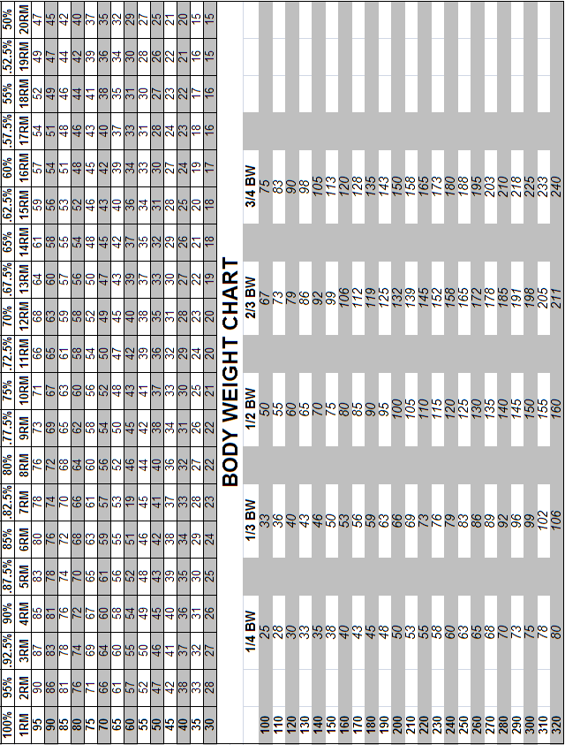

Slide 26
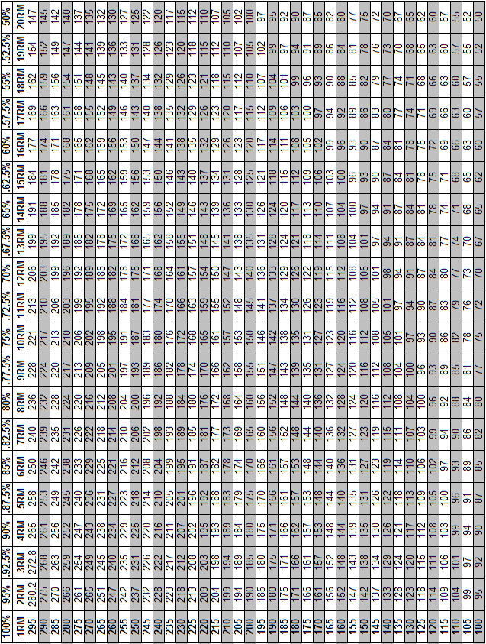

Slide 27
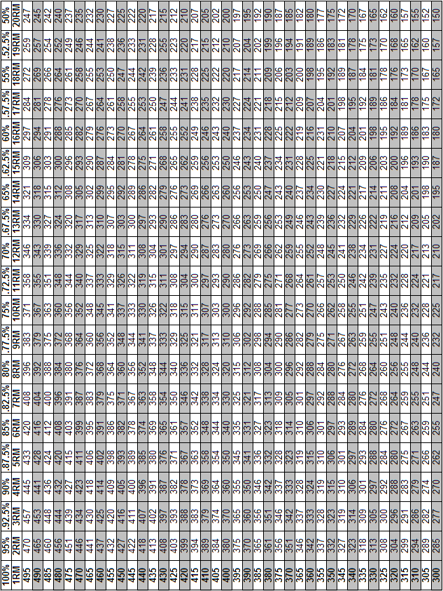

Slide 28
Alternate Lifts

Slide 29
List Of Alternative Exercises
Lower Body |  |  | Upper Body | Explosive/Olympic
DB Backsquat |  |  | Barbell Bench Press | Barbell Power Clean
DB Frontsquat |  |  | DB Bench Press | DB Power Clean
Trap Bar Dead Lift |  |  | Smith Machine Bench Press | Barbell Jump Shrug
Barbell Dead Lift |  |  | Barbell Incline Press | DB Jump Shrug
Leg Press |  |  | DB Incline Press | Power Pull
Smith Machine Backsquat |  |  | Smith Machine Incine Press | DB Power Pull
Smith Machine Frontsquat |  |  | Barbell Shoulder Press | Barbell Push Press
Full Body Squat |  |  | DB Shoulder Press | DB Push Press
Single Leg Leg Press |  |  | Smith Machine Shoulder Press | Single Arm DB Push Press
 |  |  | Single Arm Bentover Row | Box Jumps
 |  |  | Barbell Upright Row
 |  |  | DB Upright Row
 |  |  | Smith Machine Upright Row

