Slide 1

Blue Devil
Women’s Soccer
Summer Program
Summer 2012

Slide 2
Blue Devils,
Welcome to the summer, hopefully everyone did well on their exams and is ready to begin summer workouts. The following packets includes a core workout for each day, a 12 week program, and a lift of alternate exercises. The program also includes the max sheet. To clearly see the max sheet increase the visibility to 200%. The program is designed to maintain strength in preparation for the upcoming season. It is important to follow the program as it’s designed to the goals on the training phase. Also, there are videos of each exercise on the website so, if you have any questions about a video you can go to the video section of the website and click on a video and it will show you how to perform an exercise. If you have any questions about the program please email me at st_giampap@mail.ccsu.edu. Have a great summer!
Sincerely,
Coach Giampa

Slide 3
Abdominals/Low Back

Slide 4
Flexion/Extension |  |  | Plank | Rotation |  |  | Low Back
Choose 1 |  |  | Choose 1 | Choose 1: Perform |  |  | Choose 1: Perform 15 reps
 |  |  |  |  |  |  | Or Hold for :45
Regular Crunch |  |  | Side Plank Hold (Time) | Russian Twist |  |  | Dead Fish (Reps)
Crossover Crunch |  |  | Side Plank Leg Raises (Reps) | Rocky Twist |  |  | Dead Fish Hold (Time)
Elevated Crossover Crunch |  |  | Side Plank Leg Raise Hold (Time) | Prisoner Twist |  |  | Double Superman (Reps)
Side Crunch |  |  | Side Plank Hip Raises (Reps) | Squirm |  |  | Double Superman Hold (Time)
Curl Through |  |  | Side Plank Roll Unders/Hip Reach (Reps) |  |  |  | Cobra (Reps)
Wrist Curl |  |  | Front Plank Hold (Time) |  |  |  | Cobra Hold (Time)
Butterfly Crunch |  |  | Front Plank Arm Reach Hold (Time) |  |  |  | Alternate Superman (Reps)
 |  |  | Front Plank Arm Reaches (Reps) |  |  |  | Hip Bridge (Reps)
 |  |  | Front Plank Leg Raises (Reps) |  |  |  | Single Leg Hip Bridge (Reps)
 |  |  | Front Plank Leg Raise Hold (Time) |  |  |  | Hip Bridge Hold (Time)

Slide 5
Monday, May 28, 2012 |  |  | Tuesday, May 29, 2012
Exercise | Reps |  | Exercise | Reps
Side Plank | :45 |  | Flexion/Extension | 20
Flexion/Extension | 20 |  | Front Plank | :45
Rotation | 20 |  | Rotation | 20
Low Back |  |  | Low Back
Thursday, May 31, 2012 |  |  | Friday, June 1, 2012
Exercise | Reps |  | Exercise | Reps
Side Plank | :45 |  | Flexion/Extension | 20
Flexion/Extension | 20 |  | Front Plank | :45
Rotation | 20 |  | Rotation | 20
Low Back |  |  | Low Back
Monday, June 4, 2012 |  |  | Tuesday, June 5, 2012
Exercise | Reps |  | Exercise | Reps
Flexion/Extension | 20 |  | Side Plank | :45
Front Plank | :45 |  | Flexion/Extension | 20
Rotation | 20 |  | Rotation | 20
Low Back |  |  | Low Back
Thursday, June 7, 2012 |  |  | Friday, June 8, 2012
Exercise | Reps |  | Exercise | Reps
Flexion/Extension | 20 |  | Side Plank | :45
Front Plank | :45 |  | Flexion/Extension | 20
Rotation | 20 |  | Rotation | 20
Low Back |  |  | Low Back
Monday, June 11, 2012 |  |  | Tuesday, June 12, 2012
Exercise | Reps |  | Exercise | Reps
Side Plank | :45 |  | Flexion/Extension | 20
Flexion/Extension | 20 |  | Front Plank | :45
Rotation | 20 |  | Rotation | 20
Low Back |  |  | Low Back
Thursday, June 14, 2012 |  |  | Friday, June 15, 2012
Exercise | Reps |  | Exercise | Reps
Side Plank | :45 |  | Flexion/Extension | 20
Flexion/Extension | 20 |  | Front Plank | :45
Rotation | 20 |  | Rotation | 20
Low Back |  |  | Low Back

Slide 6
Monday, June 18, 2012 |  |  | Tuesday, June 19, 2012
Exercise | Reps |  | Exercise | Reps
Flexion/Extension | 25 |  | Side Plank | 1:00
Front Plank | 1:00 |  | Flexion/Extension | 25
Rotation | 25 |  | Rotation | 25
Low Back |  |  | Low Back
Thursday, June 21, 2012 |  |  | Friday, June 22, 2012
Exercise | Reps |  | Exercise | Reps
Flexion/Extension | 25 |  | Side Plank | 1:00
Front Plank | 1:00 |  | Flexion/Extension | 25
Rotation | 25 |  | Rotation | 25
Low Back |  |  | Low Back
Monday, June 25, 2012 |  |  | Tuesday, June 26, 2012
Exercise | Reps |  | Exercise | Reps
Flexion/Extension | 25 |  | Side Plank | 1:00
Front Plank | 1:00 |  | Flexion/Extension | 25
Rotation | 25 |  | Rotation | 25
Low Back |  |  | Low Back
Thursday, June 28, 2012 |  |  | Friday, June 29, 2012
Exercise | Reps |  | Exercise | Reps
Flexion/Extension | 25 |  | Flexion/Extension | 25
Front Plank | 1:00 |  | Front Plank | 1:00
Rotation | 25 |  | Rotation | 25
Low Back |  |  | Low Back
Monday, July 2, 2012 |  |  | Tuesday, July 3, 2012
Exercise | Reps |  | Exercise | Reps
Side Plank | 1:00 |  | Flexion/Extension | 25
Flexion/Extension | 25 |  | Front Plank | 1:00
Rotation | 25 |  | Rotation | 25
Low Back |  |  | Low Back
Thursday, July 5, 2012 |  |  | Friday, July 6, 2012
Exercise | Reps |  | Exercise | Reps
Side Plank | 1:00 |  | Side Plank | 1:15
Flexion/Extension | 25 |  | Flexion/Extension | 30
Rotation | 25 |  | Rotation | 30
Low Back |  |  | Low Back

Slide 7
Monday, July 9, 2012 |  |  | Tuesday, July 10, 2012
Exercise | Reps |  | Exercise | Reps
Flexion/Extension | 30 |  | Side Plank | 1:15
Front Plank | 1:15 |  | Flexion/Extension | 30
Rotation | 30 |  | Rotation | 30
Low Back |  |  | Low Back
Thursday, July 12, 2012 |  |  | Friday, July 13, 2012
Exercise | Reps |  | Exercise | Reps
Flexion/Extension | 30 |  | Flexion/Extension | 30
Front Plank | 1:15 |  | Front Plank | 1:15
Rotation | 30 |  | Rotation | 30
Low Back |  |  | Low Back
Monday, July 16, 2012 |  |  | Wednesday, July 18, 2012
Exercise | Reps |  | Exercise | Reps
Side Plank | 1:15 |  | Flexion/Extension | 30
Flexion/Extension | 30 |  | Front Plank | 1:15
Rotation | 30 |  | Rotation | 30
Low Back |  |  | Low Back
Friday, July 20, 2012 |  |  | Monday, July 23, 2012
Exercise | Reps |  | Exercise | Reps
Side Plank | 1:15 |  | Flexion/Extension | 30
Flexion/Extension | 30 |  | Front Plank | 1:15
Rotation | 30 |  | Rotation | 30
Low Back |  |  | Low Back
Tuesday, July 24, 2012 |  |  | Thursday, July 26, 2012
Exercise | Reps |  | Exercise | Reps
Side Plank | 1:15 |  | Flexion/Extension | 30
Flexion/Extension | 30 |  | Front Plank | 1:15
Rotation | 30 |  | Rotation | 30
Low Back |  |  | Low Back
Friday, July 27, 2012 |  |  | Monday, July 30, 2012
Exercise | Reps |  | Exercise | Reps
Flexion/Extension | 35 |  | Side Plank | 1:30
Front Plank | 1:30 |  | Flexion/Extension | 35
Rotation | 35 |  | Rotation | 35
Low Back |  |  | Low Back

Slide 8
Tuesday, July 31, 2012 |  |  | Thursday, August 2, 2012
Exercise | Reps |  | Exercise | Reps
Flexion/Extension | 35 |  | Side Plank | 1:30
Front Plank | 1:30 |  | Flexion/Extension | 35
Rotation | 35 |  | Rotation | 35
Low Back |  |  | Low Back
Friday, August 3, 2012 |  |  | Monday, August 6, 2012
Exercise | Reps |  | Exercise | Reps
Side Plank | 1:30 |  | Flexion/Extension | 35
Flexion/Extension | 35 |  | Front Plank | 1:30
Rotation | 35 |  | Rotation | 35
Low Back |  |  | Low Back
Tuesday, August 7, 2012 |  |  | Thursday, August 9, 2012
Exercise | Reps |  | Exercise | Reps
Side Plank | 1:30 |  | Flexion/Extension | 35
Flexion/Extension | 35 |  | Front Plank | 1:30
Rotation | 35 |  | Rotation | 35
Low Back |  |  | Low Back
Friday, August 10, 2012 |  |  | Monday, August 13, 2012
Exercise | Reps |  | Exercise | Reps
Flexion/Extension | 35 |  | Side Plank | 1:30
Front Plank | 1:30 |  | Flexion/Extension | 35
Rotation | 35 |  | Rotation | 35
Low Back |  |  | Low Back
Wednesday, August 15, 2012 |  |  | Friday, August 17, 2012
Exercise | Reps |  | Exercise | Reps
Flexion/Extension | 35 |  | Side Plank | 1:30
Front Plank | 1:30 |  | Flexion/Extension | 35
Rotation | 35 |  | Rotation | 35
Low Back |  |  | Low Back

Slide 9
Workout

Slide 10
Blue Devil Women's Soccer
Week 1
Monday, May 21, 2012
Exercise | w/up | w/up | Work set | Sets
Single Arm DB Push Press (80%) | 3-65% | 3-75% | 6-85% | 3
Double Leg Line Jump (Forward (Stick) | Superset with SA Push Press |  | 6 | 3
Bench Press | 6-60% | 6-60% | 12-70% | 3
Lat Pulldown |  |  | 12-70% | 3
3-Way Shoulder |  |  | 6 Each | 2
Inverted Row |  |  | Failure | 2
Super Circuit |  |  | 12 | 2
Tuesday, May 22, 2012
Exercise | w/up | w/up | Work set | Sets
Jump Shrug | 3-65% | 3-75% | 6-85% | 3
Double Leg Line Jump (Forward (Stick) | Superset with Jump Shrug |  | 6 | 3
Backsquat | 6-60% | 6-60% | 12-70% | 3
RDL | Use Jump Shrug Weight |  | 12 | 3
Step-ups | Use 30% Backsquat Max |  | 12 Each | 2
4-Way Physioball Hamstring |  |  | 6 Each | 2
Hyperextensions |  |  | 12 | 2
Thursday, May 24, 2012
Exercise | w/up | w/up | Work set | Sets
Single Arm DB Push Press (80% Push) | 6-55% | 6-65% | 6-75% | 3
Double Leg Line Jump (Forward) (Bounce) | Superset with SA Push Press |  | 6 | 3
Incline Bench Press | 6-55% | 6-65% | 6-75% | 3
Pull-ups |  |  | Failure | 3
Shoulder Press |  |  | 6-75% | 2
Seated Row |  |  | 6-75% | 2
Push-ups |  |  | 6+ | 2
Friday, May 25, 2012
Exercise | w/up | w/up | Work set | Sets
Jump Shrug | 6-55% | 6-65% | 6-75% | 3
Double Leg Line Jump (Forward) (Bounce) | Superset with Jump Shrug |  | 6 | 3
Backsquat | 6-55% | 6-65% | 6-75% | 3
Med-Ball Hip Raise |  |  | 6 | 3
Bulgarian Split Squat | Use 30% Backsquat Max |  | 6 Each | 2
4-Way Med-Ball Hamstring |  |  | 6 Each | 2
Reverse Hyperextensions |  |  | 6 | 2

Slide 11
Blue Devil Women's Soccer
Week 2
Monday, May 28, 2012
Exercise | w/up | w/up | Work set | Sets
Jump Shrug | 5-65% | 5-75% | 5-87.5% | 3
Double Leg Lateral Jump (Stick) | Superset with Jump Shrug |  | 5 | 3
Backsquat | 5-55% | 5-65% | 10-75% | 3
DB RDL (80% Clean) | Two DB's Should Equal Weight |  | 10-75% | 3
Forward Lunge | Use 32.5% Backsquat Max |  | 10 Each | 2
Physioball Hip Raise |  |  | 10 | 2
Hyperextensions |  |  | 10 | 2
Tuesday, May 29, 2012
Exercise | w/up | w/up | Work set | Sets
Single Arm DB Push Press (80% Push) | 5-65% | 5-75% | 5-87.5% | 3
Double Leg Lateral Jump (Stick) | Superset with SA Push Press |  | 5 | 3
DB Incline Bench Press (80% Incline) | 5-55% | 5-65% | 10-75% | 3
Pull-ups |  |  | Failure | 3
Upright Row |  |  | 10-75% | 2
Bentover Row | Use 80% Seated Row Max |  | 10-75% | 2
Super Circuit |  |  | 10 | 2
Thursday, May 31, 2012
Exercise | w/up | w/up | Work set | Sets
Jump Shrug | 5-55% | 5-65% | 5-77.5% | 3
Double Leg Lateral Jump (Bounce) | Superset with Jump Shrug |  | 5 | 3
Backsquat | 5-55% | 5-65% | 5-77.5% | 3
4-Way Med-Ball Hamstring |  |  | 5 Each | 3
Backwards Lunge | Use 32.5% Backsquat Max |  | 5 Each | 2
Sinlge Leg DB RDL (80% Clean) | Cut Weight in Half |  | 5-77.5% | 2
Reverse Hyperextensions |  |  | 5 | 2
Friday, June 1, 2012
Exercise | w/up | w/up | Work set | Sets
Jump Shrug | 5-55% | 5-65% | 5-77.5% | 3
Double Leg Lateral Jump (Bounce) | Superset with Jump Shrug |  | 5 | 3
DB Bench Press (80% Bench Max) | 5-55% | 5-65% | 5-77.5% | 3
Lat Pulldown |  |  | 5-77.5% | 3
3-Way Shoulder |  |  | 5 Each | 2
Inverted Row |  |  | Failure | 2
Push-ups |  |  | 5+ | 2

Slide 12
Blue Devil Women's Soccer
Week 3
Monday, June 4, 2012
Exercise | w/up | w/up | Work set | Sets
Single Arm DB Push Press (80% Push) | 4-70% | 4-80% | 4-90% | 3
Single Leg Line Jump Forward (Stick) | Superset with SA Push Press |  | 4 Each | 3
Bench Press | 4-60% | 4-70% | 8-80% | 3
Lat Pulldown |  |  | 8-80% | 3
Shoulder Press |  |  | 8 Each | 2
Seated Row |  |  | 8-80% | 2
Super Circuit |  |  | 8 | 2
Tuesday, June 5, 2012
Exercise | w/up | w/up | Work set | Sets
Jump Shrug | 4-70% | 4-80% | 4-90% | 3
Single Leg Line Jump Forward (Stick) | Superset with Jump Shrug |  | 4 Each | 3
Backsquat | 4-60% | 4-70% | 8-80% | 3
RDL | Use Jump Shrug Weight |  | 8 | 3
Split Squat | Use 35% Backsquat Max |  | 8 Each | 2
4-Way Physioball Hamstring |  |  | 8 Each | 2
Hyperextensions |  |  | 8 | 2
Thursday, June 7, 2012
Exercise | w/up | w/up | Work set | Sets
Box Jumps |  |  | 4 | 3
Single Leg Line Jump Forward (Bounce) | Superset with Box Jumps |  | 4 Each | 3
Incline Bench Press | 4-60% | 4-70% | 4-82.5% | 3
Pull-ups |  |  | Failure | 3
Upright Row |  |  | 4-82.5% | 2
Inverted Row |  |  | Failure | 2
Push-ups |  |  | Failure | 2
Friday, June 8, 2012
Exercise | w/up | w/up | Work set | Sets
Jump Shrug | 4-60% | 4-70% | 4-80% | 3
Single Leg Line Jump Forward (Bounce) | Superset with Jump Shrug |  | 4 Each | 3
Backsquat | 4-60% | 4-70% | 4-82.5% | 3
4-Way Med-Ball Hamstring |  |  | 4 Each | 3
Lateral Lunge | Use 35% Backsquat Max |  | 4 Each | 2
Med-Ball Hip Raise |  |  | 4 | 2
Reverse Hyperextensions |  |  | 4 | 2

Slide 13
Blue Devil Women's Soccer
Week 4: Recovery Week (No Extra Reps!)
Monday, June 11, 2012
Exercise | w/up | w/up | Work set | Sets
Jump Shrug |  | 4-60% | 4-70% | 2
Backsquat |  | 4-60% | 4-72.5% | 2
4-Way Physioball Hamstring |  |  | 4 Each | 2
Step-ups | Use 30% Backsquat Max |  | 4 Each | 2
Single Leg DB RDL (80% Clean) | Cut Weight in Half |  | 4-72.5% | 2
Hyperextensions |  |  | 4 | 2
Wednesday, June 13, 2012
Exercise | w/up | w/up | Work set | Sets
Single Arm DB Push Press (80%) |  | 4-60% | 4-70% | 2
DB Incline Bench Press (80% Incline) |  | 4-60% | 4-72.5% | 2
Pull-ups |  |  | Failure | 2
DB Shoulder Press (80% Shoulder Max) |  |  | 4-72.5% | 2
Bentover Row | Use 80% Seated Row Max |  | 4-72.5% | 2
Super Circuit |  |  | 4 | 2
Friday, June 15, 2012
Exercise | w/up | w/up | Work set | Sets
Box Jumps |  |  | 4 | 2
Backsquat |  | 4-60% | 4-72.5% | 2
DB Bench Press (80% Bench Max) |  | 4-60% | 4-72.5% | 2
RDL | Use Jump Shrug Weight |  | 4 | 2
Lat Pulldown |  |  | 4-72.5% | 2
Med-Ball Hip Raise |  |  | 4 | 2

Slide 14
Blue Devil Women's Soccer
Week 5
Monday, June 18, 2012
Exercise | w/up | w/up | Work set | Sets
DB Push Press (80% Push Press Max) | 5-65% | 5-75% | 5-87.5% | 3
Single Leg Lateral Line Jump (Stick) | Superset with DB Push Press |  | 5 Each | 3
DB Bench Press (80% Bench Max) | 5-55% | 5-65% | 10-75% | 3
Lat Pulldown |  |  | 10-75% | 3
3-Way Shoulder |  |  | 5 Each | 2
Seated Row |  |  | 10-75% | 2
Super Circuit |  |  | 10 | 2
Tuesday, June 19, 2012
Exercise | w/up | w/up | Work set | Sets
Power Pull | 5-65% | 5-75% | 5-87.5% | 3
Single Leg Lateral Line Jump (Stick) | Superset with Power Pull |  | 5 Each | 3
Backsquat | 5-55% | 5-65% | 10-75% | 3
RDL | Use Power Pull Weight |  | 10 | 3
Forward Lunge | Use 32.5% Backsquat Max |  | 10 Each | 2
Med-Ball Hip Raise |  |  | 10 | 2
Hyperextensions |  |  | 10 | 2
Thursday, June 21, 2012
Exercise | w/up | w/up | Work set | Sets
Box Jumps |  |  | 5 | 3
Single Leg Lateral Line Jump (Bounce) | Superset with Box Jumps |  | 5 Each | 3
DB Incline Bench Press (80% Incline) | 5-55% | 5-65% | 5-77.5% | 3
Pull-ups |  |  | Failure | 3
DB Shoulder Press |  |  | 5-77.5% | 2
Inverted Row |  |  | Failure | 2
Push-ups |  |  | Failure | 2
Friday, June 22, 2012
Exercise | w/up | w/up | Work set | Sets
Jump Shrug | 5-55% | 5-65% | 5-77.5% | 3
Single Leg Lateral Line Jump (Bounce) | Superset with Jump Shrug |  | 5 Each | 3
Backsquat | 5-55% | 5-65% | 5-77.5% | 3
Single Leg DB RDL (80% Clean) | Cut DB in Half |  | 5-77.5% | 3
Split Squat | Use 32.5% Backsquat Max |  | 5 Each | 2
4-Way Med-Ball Hamstring |  |  | 5 Each | 2
Reverse Hyperextensions |  |  | 5 | 2

Slide 15
Blue Devil Women's Soccer
Week 6
Monday, June 25, 2012
Exercise | w/up | w/up | Work set | Sets
Power Pull | 4-70% | 4-80% | 4-90% | 3
Box Jumps Forward | Superset with Power Pull |  | 4 | 3
Backsquat | 4-60% | 4-70% | 8-80% | 3
4-Way Physioball Hamstring |  |  | 8 Each | 3
Backwards Lunge | Use 35% Backsquat Max |  | 8 Each | 2
Physioball Hip Raise |  |  | 8 | 2
Hyperextensions |  |  | 8 | 2
Tuesday, June 26, 2012
Exercise | w/up | w/up | Work set | Sets
Push Press | 4-70% | 4-80% | 4-90% | 3
Box Jumps Forward | Superset with Push Press |  | 4 | 3
Incline Bench Press | 4-60% | 4-70% | 8-80% | 3
Pull-ups |  |  | Failure | 3
Shoulder Press |  |  | 8-80% | 2
Bentover Row | Use 80% Seated Row Max |  | 8-80% | 2
Super Circuit |  |  | 8 | 2
Thursday, June 28, 2012
Exercise | w/up | w/up | Work set | Sets
Jump Shrug | 4-60% | 4-70% | 4-80% | 3
Lateral Box Jumps | Superset with Jump Shrug |  | 4 Each | 3
Backsquat | 4-60% | 4-70% | 4-82.5% | 3
RDL | Use Jump Shrug Weight |  | 4 | 3
Lateral Lunge | Use 35% Backsquat Max |  | 4 Each | 2
Single Leg DB RDL (80% Clean) | Cut Weight in Half |  | 4-80% | 2
Reverse Hyperextensions |  |  | 4 | 2
Friday, June 29, 2012
Exercise | w/up | w/up | Work set | Sets
Box Jumps |  |  | 4 | 3
Lateral Box Jumps | Superset with Box Jumps |  | 4 Each | 3
Bench Press | 4-60% | 4-70% | 4-82.5% | 3
Lat Pulldown |  |  | 4-82.5% | 3
Upright Row |  |  | 4-82.5% | 2
Seated Row |  |  | 4-82.5% | 2
Push-ups |  |  | Failure | 2

Slide 16
Blue Devil Women's Soccer
Week 7
Monday, July 2, 2012
Exercise | w/up | w/up | Work set | Sets
Push Press | 3-70% | 3-80% | 3-92.5% | 3
Single Leg Box Jumps (Forward) | Superset with Push Press |  | 3 Each | 3
DB Bench Press (80% Bench Max) | 3-65% | 3-75% | 6-85% | 3
Lat Pulldown |  |  | 6-85% | 3
3-Way Shoulder |  |  | 6 Each | 2
Inverted Row |  |  | Failure | 2
Super Circuit |  |  | 6 | 2
Tuesday, July 3, 2012
Exercise | w/up | w/up | Work set | Sets
Power Pull | 3-70% | 3-80% | 3-92.5% | 3
Single Leg Box Jumps (Forward) | Superset with Power Pull |  | 3 Each | 3
Backsquat | 3-65% | 3-75% | 6-85% | 3
RDL | Use Power Pull Weight |  | 6 | 3
Bulgarian Split Squat | Use 37.5% Backsquat Max |  | 6 Each | 2
4-Way Med-Ball Hamstring |  |  | 6 Each | 2
Hyperextensions |  |  | 6 | 2
Thursday, July 5, 2012
Exercise | w/up | w/up | Work set | Sets
Box Jumps |  |  | 6 | 3
Single Leg Lateral Box Jumps | Superset with Box Jumps |  | 6 | 3
DB Incline Bench Press (80% Incline Max) | 3-65% | 3-75% | 3-87.5% | 3
Pull-ups |  |  | Failure | 3
DB Shoulder Press (80% Shoulder Max) |  |  | 3-87.5% | 2
Bentover Row | Use 80% Seated Row Max |  | 3-87.5% | 2
Push-ups |  |  | Failure | 2
Friday, July 6, 2012
Exercise | w/up | w/up | Work set | Sets
Jump Shrug | 3-60% | 3-70% | 3-82.5% | 3
Single Leg Lateral Box Jumps | Superset with Jump Shrug |  | 3 Each | 3
Backsquat | 3-65% | 3-75% | 3-87.5% | 3
Med-Ball Hip Raise |  |  | 3 | 3
Step-ups | Use 37.5% Backsquat Max |  | 3 Each | 2
4-Way Physioball Hamstring |  |  | 3 Each | 2
Reverse Hyperextensions |  |  | 6 | 2

Slide 17
Blue Devil Women's Soccer
Week 8: Recovery Week (No Extra Reps!)
Monday, July 9, 2012
Exercise | w/up | w/up | Work set | Sets
Power Pull |  | 3-60% | 3-72.5% | 2
Backsquat |  | 3-65% | 3-77.5% | 2
Single Leg DB RDL (80% Clean) | Cut Weight in Half |  | 3-72.5% | 2
Forward Lunge | Use 30% Backsquat Max |  | 3 Each | 2
Med-Ball Hip Raise |  |  | 3 | 2
Hyperextensions |  |  | 6 | 2
Wednesday, July 11, 2012
Exercise | w/up | w/up | Work set | Sets
Push Press |  | 3-60% | 3-72.5% | 2
Incline Bench Press |  | 3-65% | 3-77.5% | 2
Pull-ups |  |  | Failure | 2
Upright Row |  |  | 3-77.5% | 2
Seated Row |  |  | 3-77.5% | 2
Super Circuit |  |  | 6 | 2
Friday, July 13, 2012
Exercise | w/up | w/up | Work set | Sets
Box Jumps |  |  | 3 | 2
Backsquat |  | 3-65% | 3-77.5% | 2
Bench Press |  | 3-65% | 3-77.5% | 2
RDL | Use Jump Shrug Weight |  | 3 | 2
Lat Pulldown |  |  | 3-77.5% | 2
Backwards Lunge | Use 30% Backsquat Max |  | 3 Each | 2

Slide 18
Blue Devil Women's Soccer
Week 9
Monday, July 16, 2012
Exercise | w/up | w/up | Work set | Sets
Push Press | 4-70% | 4-80% | 4-90% | 3
Depth Drop | Superset with Push Press |  | 4 | 3
Bench Press | 4-60% | 4-70% | 8-80% | 3
Lat Pulldown |  |  | 8-80% | 3
3-Way Shoulder |  |  | 8 Each | 2
Bentover Row | Use 80% Seated Row Max |  | 8-80% | 2
Super Circuit |  |  | 8 | 2
Tuesday, July 17, 2012
Exercise | w/up | w/up | Work set | Sets
Power Pull | 4-70% | 4-80% | 4-90% | 3
Depth Drop | Superset with Power Pull |  | 4 | 3
Backsquat | 4-60% | 4-70% | 8-80% | 3
RDL | Use Power Pull Weight |  | 8 | 3
Lateral Lunge | Use 35% Backsquat Max |  | 8 Each | 2
4-Way Physioball Hamstring |  |  | 8 Each | 2
Hyperextensions |  |  | 8 | 2
Thursday, July 19, 2012
Exercise | w/up | w/up | Work set | Sets
Box Jumps |  |  | 4 | 3
Squat Jumps | Superset with Box Jumps |  | 4 | 3
Incline Bench Press | 4-60% | 4-70% | 4-82.5% | 3
Pull-ups |  |  | Failure | 3
Shoulder Press |  |  | 4-82.5% | 2
Inverted Row |  |  | Failure | 2
Push-ups |  |  | Failure | 2
Friday, July 20, 2012
Exercise | w/up | w/up | Work set | Sets
Jump Shrug | 4-60% | 4-70% | 4-80% | 3
Squat Jumps | Superset with Jump Shrug |  | 4 | 3
Backsquat | 4-60% | 4-70% | 4-82.5% | 3
Single Leg DB RDL (80% Clean) | Cut Weight in Half |  | 4-82.5% | 3
Bulgarian Split Squat | Use 35% Backsquat Max |  | 4 Each | 2
Med-Ball Hip Raise |  |  | 4 | 2
Reverse Hyperextensions |  |  | 4 | 2

Slide 19
Blue Devil Women's Soccer
Week 10
Monday, July 23, 2012
Exercise | w/up | w/up | Work set | Sets
Power Pull | 3-70% | 3-80% | 3-92.5% | 3
Lateral Skater Drives | Superset with Power Pull |  | 3 | 3
Backsquat | 3-65% | 3-75% | 6-85% | 3
4-Way Med-Ball Hamstring |  |  | 6 Each | 3
Step-ups | Use 37.5% Backsquat Max |  | 6 Each | 2
Med-Ball Hip Raise |  |  | 6 | 2
Hyperextensions |  |  | 6 | 2
Tuesday, July 24, 2012
Exercise | w/up | w/up | Work set | Sets
Push Press | 3-70% | 3-80% | 3-92.5% | 3
Lateral Skater Drives | Superset with Push Press |  | 3 | 3
DB Incline Bench Press (80% Incline) | 3-65% | 3-75% | 6-85% | 3
Pull-ups |  |  | Failure | 3
Upright Row |  |  | 6-85% | 2
Seated Row |  |  | 6-85% | 2
Super Circuit |  |  | 6 | 2
Thursday, July 26, 2012
Exercise | w/up | w/up | Work set | Sets
Jump Shrug | 3-60% | 3-70% | 3-82.5% | 3
Split Squat Jumps | Superset with Jump Shrug |  | 3 | 3
Backsquat | 3-65% | 3-75% | 3-87.5% | 3
RDL | Use Jump Shrug Weight |  | 3 | 3
Split Squat | Use 37.5% Backsquat Max |  | 3 Each | 2
Single Leg DB RDL (80% Clean) | Cut Weight in Half |  | 3-87.5% | 2
Reverse Hyperextensions |  |  | 6 | 2
Friday, July 27, 2012
Exercise | w/up | w/up | Work set | Sets
Box Jumps |  |  | 6 | 3
Split Squat Jumps | Superset with Box Jumps |  | 3 | 3
DB Bench Press (80% Bench Max) | 3-65% | 3-75% | 3-87.5% | 3
Lat Pulldown |  | 3-75% | 3-87.5% | 3
3-Way Shoulder |  |  | 3 Each | 2
Inverted Row |  |  | Failure | 2
Push-ups |  |  | Failure | 2

Slide 20
Blue Devil Women's Soccer
Week 11
Monday, July 30, 2012
Exercise | w/up | w/up | Work set | Sets
Push Press | 2-75% | 2-85% | 2-95% | 3
Double Leg Box Drill | Superset with Push Press |  | 2 | 3
Bench Press | 4-70% | 4-80% | 4-90% | 3
Lat Pulldown |  |  | 4-90% | 3
Upright Row |  |  | 4 Each | 2
Bentover Row | Use 80% Seated Row Max |  | 4-90% | 2
Super Circuit |  |  | 4 | 2
Tuesday, July 31, 2012
Exercise | w/up | w/up | Work set | Sets
Power Pull | 2-75% | 2-85% | 2-95% | 3
Double Leg Box Drill | Superset with Power Pull |  | 2 | 3
Backsquat | 4-70% | 4-80% | 4-90% | 3
RDL | Use Power Pull Weight |  | 4 | 3
Forward Lunge | Use 40% Backsquat Max |  | 4 Each | 2
4-Way Physioball Hamstring |  |  | 4 Each | 2
Hyperextensions |  |  | 4 | 2
Thursday, August 2, 2012
Exercise | w/up | w/up | Work set | Sets
Box Jumps |  |  | 4 | 3
Single Leg Box Drill | Superset with Box Jumps |  | 2 | 3
Incline Bench Press | 2-70% | 2-80% | 2-92.5% | 3
Pull-ups |  |  | Failure | 3
Shoulder Press |  |  | 2-92.5% | 2
Seated Row |  |  | 2-92.5% | 2
Push-ups |  |  | Failure | 2
Friday, August 3, 2012
Exercise | w/up | w/up | Work set | Sets
Jump Shrug | 2-65% | 2-75% | 2-85% | 3
Single Leg Box Drill | Superset with Jump Shrug |  | 2 | 3
Backsquat | 2-70% | 2-80% | 2-92.5% | 3
Single Leg DB RDL (80% Clean) | Cut Weight in Half |  | 4-92.5% | 3
Backwards Lunge | Use 40% Backsquat Max |  | 2 Each | 2
Med-Ball Hip Raise |  |  | 4 Each | 2
Reverse Hyperextensions |  |  | 4 | 2

Slide 21
Blue Devil Women's Soccer
Week 12: Recovery Week (No Extra Reps!)
Monday, August 6, 2012
Exercise | w/up | w/up | Work set | Sets
Power Pull |  | 2-65% | 2-75% | 2
Backsquat |  | 2-75% | 2-82.5% | 2
4-Way Med-Ball Hamstring |  |  | 2 Each | 2
Lateral Lunge | Use 30% Backsquat Max |  | 2 Each | 2
Med-Ball Hip Raise |  |  | 2 | 2
Hyperextensions |  |  | 2 | 2
Wednesday, August 8, 2012
Exercise | w/up | w/up | Work set | Sets
Push Press |  | 2-65% | 2-75% | 2
Incline Bench Press |  | 2-75% | 2-82.5% | 2
Pull-ups |  |  | Failure | 2
Shoulder Press |  |  | 2-82.5% | 2
Seated Row |  |  | 2-82.5% | 2
Super Circuit |  |  | 4 | 2
Friday, August 10, 2012
Exercise | w/up | w/up | Work set | Sets
Box Jumps |  |  | 2 | 2
Backsquat |  | 2-75% | 2-82.5% | 2
Bench Press | 2-65% | 2-75% | 2-82.5% | 2
RDL |  |  | 2 | 2
Lat Pulldown |  |  | 2-82.5% | 2
Reverse Hyperextensions |  |  | 4 | 2

Slide 22
Max Sheet

Slide 23
Blue Devil Women's Soccer Max Sheet
 | JUMP SHRUG |  |  |  | BACK SQUAT |  |  |  | FRONT SQUAT |  |  |  | PUSH PRESS |  |  |  | BENCH |  |  |  | DEADLIFT |  |  |  | SNATCH |  |  |  | INCLINE PRESS
MAX CHART | MAX | WU | WU | WS | MAX | WU | WU | WS | MAX | WU | WU | WS | MAX | WU | WU | WS | MAX | WU | WU | WS | MAX | WU | WU | WS | MAX | WU | WU | WS | MAX | WU | WU | WS
NAME |  | 0.0% | 0.0% | 0.0% |  | 40.0% | 50.0% | 60.0% |  | 0.0% | 0.0% | 0.0% |  | 0.0% | 0.0% | 0.0% |  | 0.0% | 0.0% | 0.0% |  | 60.0% | 70.0% | 80.0% |  | 0.0% | 0.0% | 0.0% |  | 0.0% | 0.0% | 0.0%
Ashley, B | 105 | 0 | 0 | 0 | 180 | 75 | 90 | 110 | 126 | 0 | 0 | 0 | 55 | 0 | 0 | 0 | 85 | 0 | 0 | 0 | 130 | 80 | 95 | 105 | 78.75 | 0 | 0 | 0 | 68 | 0 | 0 | 0
Christina, B | 105 | 0 | 0 | 0 | 105 | 45 | 55 | 65 | 73.5 | 0 | 0 | 0 | 50 | 0 | 0 | 0 | 70 | 0 | 0 | 0 | 115 | 70 | 85 | 95 | 78.75 | 0 | 0 | 0 | 56 | 0 | 0 | 0
Cara, C | 105 | 0 | 0 | 0 | 145 | 60 | 75 | 90 | 101.5 | 0 | 0 | 0 | 62 | 0 | 0 | 0 | 100 | 0 | 0 | 0 | 145 | 90 | 105 | 120 | 78.75 | 0 | 0 | 0 | 80 | 0 | 0 | 0
Rachel, C | 105 | 0 | 0 | 0 | 145 | 60 | 75 | 90 | 101.5 | 0 | 0 | 0 | 62 | 0 | 0 | 0 | 100 | 0 | 0 | 0 | 145 | 90 | 105 | 120 | 78.75 | 0 | 0 | 0 | 80 | 0 | 0 | 0
Julie, L | 105 | 0 | 0 | 0 | 110 | 45 | 55 | 70 | 77 | 0 | 0 | 0 | 50 | 0 | 0 | 0 | 75 | 0 | 0 | 0 | 115 | 70 | 85 | 95 | 78.75 | 0 | 0 | 0 | 60 | 0 | 0 | 0
Nikola, D | 105 | 0 | 0 | 0 | 0 | 0 | 0 | 0 | 0 | 0 | 0 | 0 | 57 | 0 | 0 | 0 | 90 | 0 | 0 | 0 | 0 | 0 | 0 | 0 | 78.75 | 0 | 0 | 0 | 72 | 0 | 0 | 0
Erin, E | 105 | 0 | 0 | 0 | 150 | 60 | 75 | 90 | 105 | 0 | 0 | 0 | 57 | 0 | 0 | 0 | 90 | 0 | 0 | 0 | 125 | 75 | 90 | 100 | 78.75 | 0 | 0 | 0 | 72 | 0 | 0 | 0
Annie, F | 105 | 0 | 0 | 0 | 145 | 60 | 75 | 90 | 101.5 | 0 | 0 | 0 | 57 | 0 | 0 | 0 | 90 | 0 | 0 | 0 | 115 | 70 | 85 | 95 | 78.75 | 0 | 0 | 0 | 75 | 0 | 0 | 0
Alex, D | 105 | 0 | 0 | 0 | 145 | 60 | 75 | 90 | 101.5 | 0 | 0 | 0 | 60 | 0 | 0 | 0 | 100 | 0 | 0 | 0 | 135 | 85 | 95 | 110 | 78.75 | 0 | 0 | 0 | 80 | 0 | 0 | 0
Leanne, H | 105 | 0 | 0 | 0 | 165 | 70 | 85 | 100 | 115.5 | 0 | 0 | 0 | 60 | 0 | 0 | 0 | 100 | 0 | 0 | 0 | 120 | 75 | 85 | 100 | 78.75 | 0 | 0 | 0 | 80 | 0 | 0 | 0
Allison, K | 105 | 0 | 0 | 0 | 145 | 60 | 75 | 90 | 101.5 | 0 | 0 | 0 | 60 | 0 | 0 | 0 | 90 | 0 | 0 | 0 | 145 | 90 | 105 | 120 | 78.75 | 0 | 0 | 0 | 72 | 0 | 0 | 0
Nikki, K | 105 | 0 | 0 | 0 | 170 | 70 | 85 | 105 | 119 | 0 | 0 | 0 | 60 | 0 | 0 | 0 | 100 | 0 | 0 | 0 | 145 | 90 | 105 | 120 | 78.75 | 0 | 0 | 0 | 80 | 0 | 0 | 0
Danica, F | 105 | 0 | 0 | 0 | 135 | 55 | 70 | 85 | 94.5 | 0 | 0 | 0 | 50 | 0 | 0 | 0 | 80 | 0 | 0 | 0 | 120 | 75 | 85 | 100 | 78.75 | 0 | 0 | 0 | 64 | 0 | 0 | 0
Jewel, R | 105 | 0 | 0 | 0 | 275 | 110 | 140 | 165 | 192.5 | 0 | 0 | 0 | 50 | 0 | 0 | 0 | 100 | 0 | 0 | 0 | 145 | 90 | 105 | 120 | 78.75 | 0 | 0 | 0 | 80 | 0 | 0 | 0
Kerrian, W | 105 | 0 | 0 | 0 | 135 | 65 | 70 | 85 | 94.5 | 0 | 0 | 0 | 50 | 0 | 0 | 0 | 100 | 0 | 0 | 0 | 125 | 75 | 90 | 100 | 78.75 | 0 | 0 | 0 | 85 | 0 | 0 | 0
Lauren, V | 105 | 0 | 0 | 0 | 160 | 65 | 80 | 100 | 112 | 0 | 0 | 0 | 50 | 0 | 0 | 0 | 90 | 0 | 0 | 0 | 130 | 80 | 95 | 105 | 78.75 | 0 | 0 | 0 | 72 | 0 | 0 | 0
Katie | 85 | 0 | 0 | 0 | 140 | 60 | 70 | 85 | 98 | 0 | 0 | 0 | 50 | 0 | 0 | 0 | 75 | 0 | 0 | 0 | 110 | 70 | 80 | 90 | 63.75 | 0 | 0 | 0 | 60 | 0 | 0 | 0
Caitlynn | 85 | 0 | 0 | 0 | 115 | 50 | 60 | 70 | 80.5 | 0 | 0 | 0 | 60 | 0 | 0 | 0 | 85 | 0 | 0 | 0 | 125 | 75 | 90 | 100 | 63.8 | 0 | 0 | 0 | 68 | 0 | 0 | 0
Corey | 85 | 0 | 0 | 0 | 135 | 55 | 70 | 85 | 101 | 0 | 0 | 0 | 60 | 0 | 0 | 0 | 105 | 0 | 0 | 0 | 135 | 85 | 95 | 110 | 63.8 | 0 | 0 | 0 | 84 | 0 | 0 | 0

Slide 24
Max Chart

Slide 25
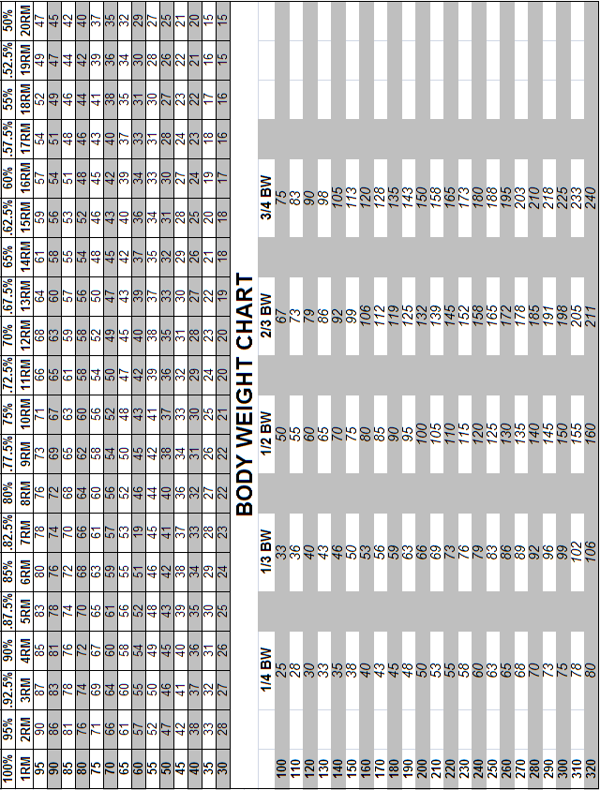

Slide 26
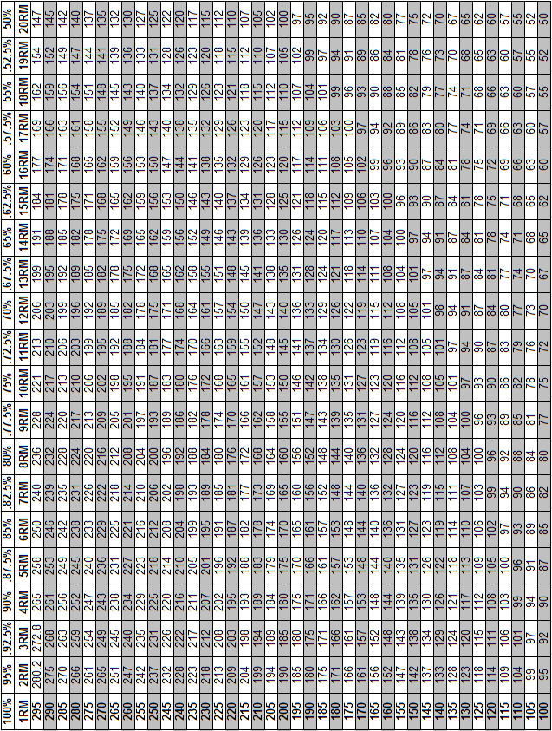

Slide 27
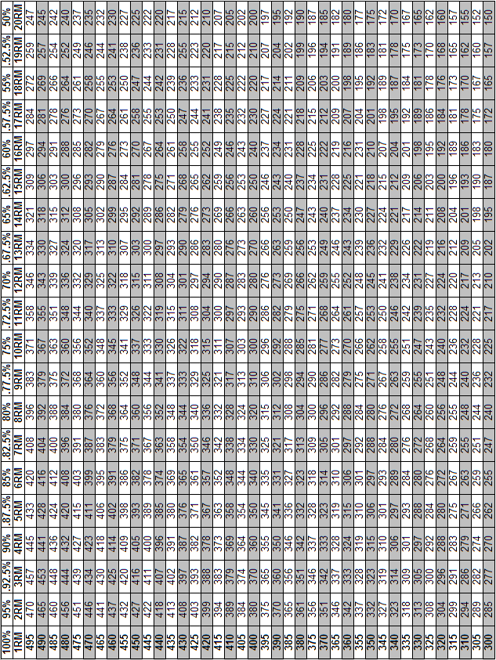

Slide 28
Alternate Lifts

Slide 29
List Of Alternative Exercises
Lower Body |  |  | Upper Body | Explosive/Olympic
DB Backsquat |  |  | Barbell Bench Press | Barbell Power Clean
DB Frontsquat |  |  | DB Bench Press | DB Power Clean
Trap Bar Dead Lift |  |  | Smith Machine Bench Press | Barbell Jump Shrug
Barbell Dead Lift |  |  | Barbell Incline Press | DB Jump Shrug
Leg Press |  |  | DB Incline Press | Power Pull
Smith Machine Backsquat |  |  | Smith Machine Incine Press | DB Power Pull
Smith Machine Frontsquat |  |  | Barbell Shoulder Press | Barbell Push Press
Full Body Squat |  |  | DB Shoulder Press | DB Push Press
Single Leg Leg Press |  |  | Smith Machine Shoulder Press | Single Arm DB Push Press
 |  |  | Single Arm Bentover Row | Box Jumps
 |  |  | Barbell Upright Row
 |  |  | DB Upright Row
 |  |  | Smith Machine Upright Row

